Slide 1
Integration Group
GMLD Workshop 2012

Slide 2
Members
Vladimir Dimitrieski
Hans-Georg Fill
Heiko Kern
Rolf-Helge Pfeiffer
Petr Smolik
Gabriele Taentzer

Slide 3
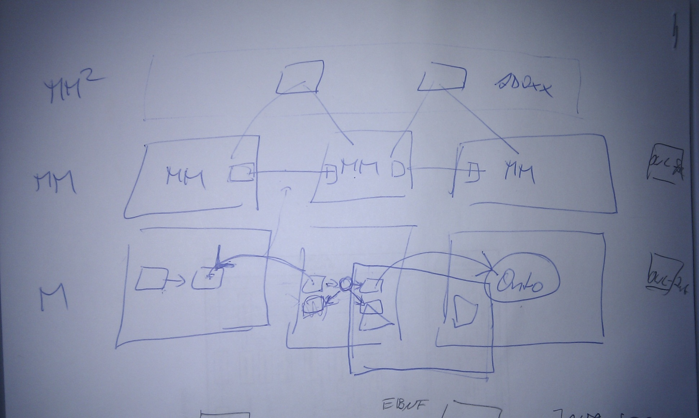
Integration via mapping model
Vertical integration vs horizontal integration

Slide 4
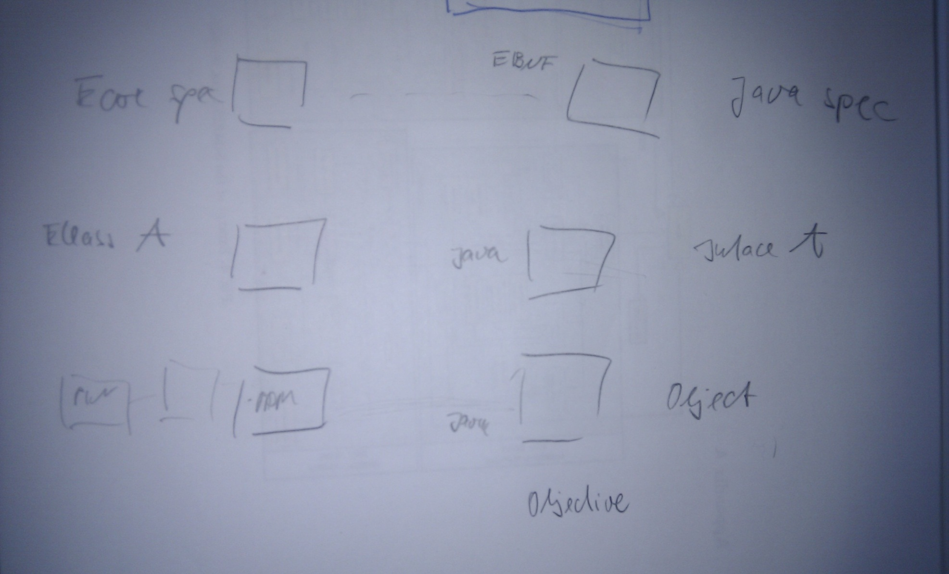
Characteristics of integration
Switching levels
Model level must be clear

Slide 5
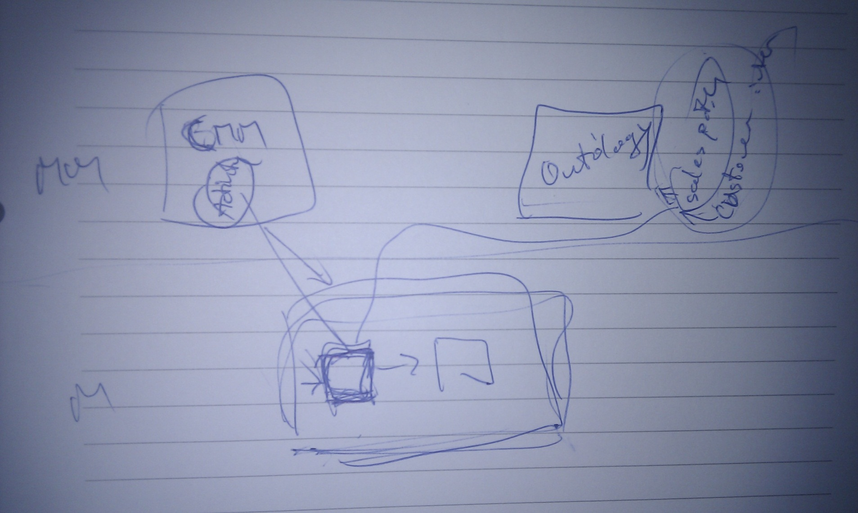
Multiple metamodel instantiation

Slide 6
Techniques to integrate metamodels
Integration of metamodels: duplicate elements
  Role-base modeling
  Stereotypes
  Building of views
Realization of model mapping
  Same name
  Copy

Slide 7
Conclusion
Integration depends on
  the objectives of the integration
  the structure of the integration objects
    models
    abstraction level of the models
    model level

