Slide 1
The GDSE Framework A Meta-Tool for Automated Design Space Exploration
Tripti Saxena
Graduate Student
Vanderbilt University

Slide 2
Outline
Background
Motivation
The Generic Design Space Exploration Framework
Reconfigurable Representation
Flexible Exploration
Conclusion and Future Work

Slide 3
Background
x2
Design Space
product of possible discrete design choices
e.g. selection of software components
alternative hardware architectures
selection of features
Design Space Exploration
find a design point
Satisfies constraints
Is “best” w.r.t. an objective function(s)
design
space
x1
Notes:
For example

Slide 4
Background
Software Product-line Engineering
Face Recognition System
[1..4]
Camera
Face Recognition Algorithm
Image Compression
PCA
LDA
Bayesian
Euclidean
MahCosine
Euclidean
IdaSoft
MAP
ML
Feature Model
Notes:
System is a set of reusable assets called features. A set of feature selections results in a product which a point in the design space. Set of possible feature selections create a design space and the goal is to find feature selections that satisfy constraints.

Slide 5
Background
Embedded Systems
Application
Hardware
LookUp
RISC
EDF
TDMA
Priority
WFQ
Cipher
DSP
Mapping
Notes:
We have variants of software application that is mapped on to a variant of the hardware . A point in the design space is one variant mapped to one variant of hardware, goal is find a design which satisfies resource constraints.

Slide 6
Current DSE Frameworks
Representation
Design space
Constraints
Objectives
Exploration
Solver
Exploration algorithm
Examples of DSE frameworks
FAMA
Milan
SPLOT
PISA
…
Configured to solve a particular DSE problem
Supports only ONE solver/solving technique, not efficient for every problem instance.
Notes:
Start with the domain specific representation of the design space. For example Feature Models are used in SPLE
The constraints that valid design configurations should satisfy and the objective the exploration.
In the backend this problem specification is refined to a constraint problem that is fed to a particular constraint solver
The constraint solver checks in there are any satisfying solutions to the problem
This works fine for a given problem in one domain
-problem when same exploration algorithm/solver needs to be used for another domain…cannot reuse the framework
-same problem can be solved using different solvers…efficiency of a particular solver depends on the problem instance…so fixed solver can work efficiently only on
For example OBDD solvers are very efficient in finding valid design alternatives in the presence of boolean constraints
But will not work very well if

Slide 7
Motivation
A reusable and flexible framework
SAT
(e.g. Minisat)
Hardware-Software
Mapping
Mathematical
Solver
(e.g. LPSolve)
Software
Product Line
configuration
Common
core
Constraint
Solver
(e.g Gecode)
Web Server
configuration
Reusable Core
Reconfigurable Representation
Multiple Solvers
Notes:
In order to overcome the limitations of the current framework
Should be able to use the same framework to model DSE problems from different domains
Reuse of common DSE concepts so that the domain-engineers just need to focus on domain-specific characteristics rather than reimplementing similar functionality again and again.
Flexibility to choose from a set of solvers

Slide 8
The Generic Design Space Exploration Framework
DSML
ADSEL Template
GME
Model Transformation
Common Core
eDSML
Intermediate Language
Instance of
Instance of
Intermediate Design Space Model
DESERT
Design Space Model
t
Flexible Exploration
Solver Independent Constraint Problem in Minizinc
Minizinc
Reconfigurable Representation
FlatZinc Solver
LP Solver
FD Solver
Gecode
Solver
Notes:
GDSE Framework is a metaprogrammable tool based on GME and minizinc. It has three main parts
which can be reconfigured to represent DSE problems from different domains which is configured once for a kind of DSE problem. This is done by association of DSE characteristics to any DSML
Common core: Remains the same as we move from one domain to the other
Flexibile Exploration: that enables domain-engineer to invoke a different solver on per instance basis.
It supports reusable artifacts that can be reused as the
The domain-expert can metaprogram the framework to work with a DSE problem from any domain and once this is done the domain-engineer can use this framework to model instances of his DSE problem and choose a solver to solve the DSE problem.
Supports reuse by association of DSE characteristics to any DSML.

Slide 9
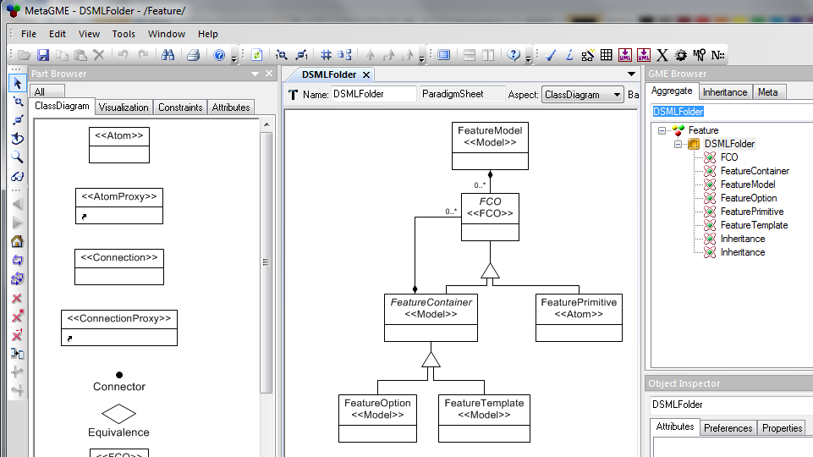
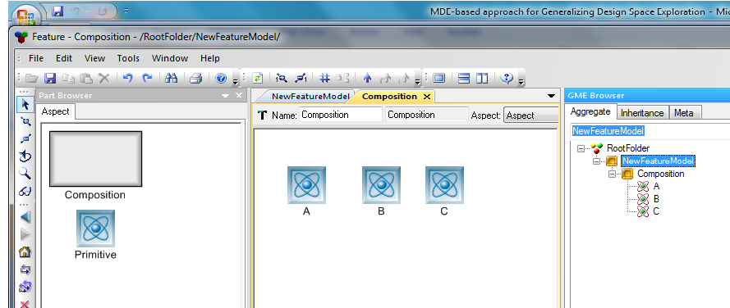
Generic Modeling Environment
Metamodeling
MDE-based Framework
Meta-Programmable
Reuse of previously defined entities using libraries
Translators for synthesis
Done by Domain experts
Modeling
Enables reconfigurable representation
Done by Domain-engineers
Notes:
Generic Modeling Environment
- meta programmable framework where the same environment is used to model and metamodel.
- language specification is captured using stereotyped UML step model and uses predefined interpretors take this language specification and configure GME to create a domain-specific environment.

Slide 10
Minizinc
Medium Level
Solver-Independent Language
Express Combinatorial Search Problems
Predefined translators for translation to different solver specific formats
Model
Interpreter
Simplified Constraints + variables
Constraint Solver (Flatzinc)
LP Solve
Minisat
Enables flexible exploration
Solutions
Solutions
Solutions

Slide 11
Overview of the GDSE Framework
DSML
1
ADSEL
GME
4
Reuse existing DSML
Model Transformation
Intermediate Language
2
eDSML
Instance of
Instance of
Intermediate Design Space Model
DESERT
Design Space Model
t
3
Solver Independent Constraint Problem in Minizinc
FlatZinc Solver
LP Solver
FD Solver
Gecode
Solver
Notes:
The framework has to be configured to represent the DSE problem in a given domain. Steps 1 and 2 are performed to do this. The configuration starts with step 1 Starts with the specification of DSML. 1 is performed once for every domain and 2 is performed once for every kind of DSE problem to be solved
3 and 4 are performed iteratively by a domain engineer during the design process.

Slide 12
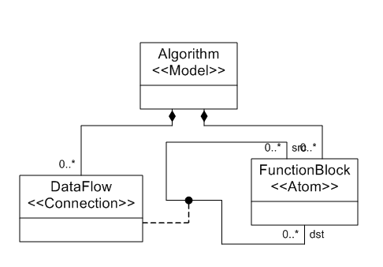
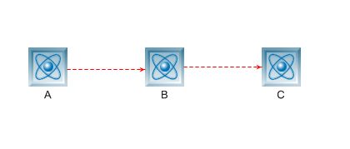
Step 1: Domain Specific Modeling Language.
Metamodel
Entities
Relationships
Attributes
Metamodel
Face Recognition Algorithm
Model
Notes:
This DSML is used for creation of a point design . One algorithm.
We need to extend the representation to capture a design space.

Slide 13
DSE Problem: Face Recognition System
Construct a Face Recognition System
Goal: Choose a face recognition algorithm from the variants satisfying selection + resource constraints
DSML has to be extended to capture
Design Space of possible variants
DSE Properties
Memory
CPU
Cost
Constraints
Bound constraint : Memory <= x
Objective
PCA
Algo1
Algo2
Algo3
…
Notes:
This DSML is used for creation of a point design . One algorithm.
We need to extend the representation to capture a design space.

Slide 14
Step 2: Metamodel Composition
GME
DSML
1
ADSEL
GME
4
Performed by Domain-expert ONCE for a kind of DSE problem
Model Transformation
Intermediate Language
2
eDSML
Instance of
Instance of
Intermediate Design Space Model
DESERT
Design Space Model
t
3
Solver Independent Constraint Problem in Minizinc
FlatZinc Solver
LP Solver
FD Solver
Gecode
Solver
Notes:
Superimpose DSE characteristics onto the DSML elements. This is done by metamodel composition with a metamodel template consisting of these core DSE concepts. This step is performed by once by the domain-expert.

Slide 15
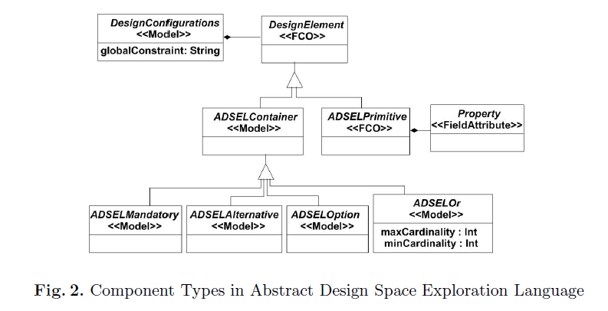
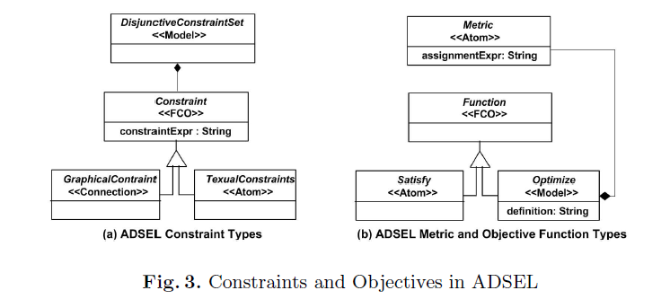
The Abstract Design Space Exploration Language Template
Design Space Tree
COMPONENT TYPES
CONSTRAINT TYPES
OBJECTIVE TYPES
Objective
All elements are abstract !
Notes:
Is the core reconfigurable representation in GDSE Framework. Enables reuse of common DSE elements while modeling different DSE problems
Also it enables association of
It enables association of DSE characteristics with the DSML.
Component types : which provide a generic representation to hierarchically structure the design alternatives
Constraints types: which capture the interaction between the design alternatives, the different constraints each valid design alternative should satisfy
Objective Types : which captures the goal of the exploration .

Slide 16
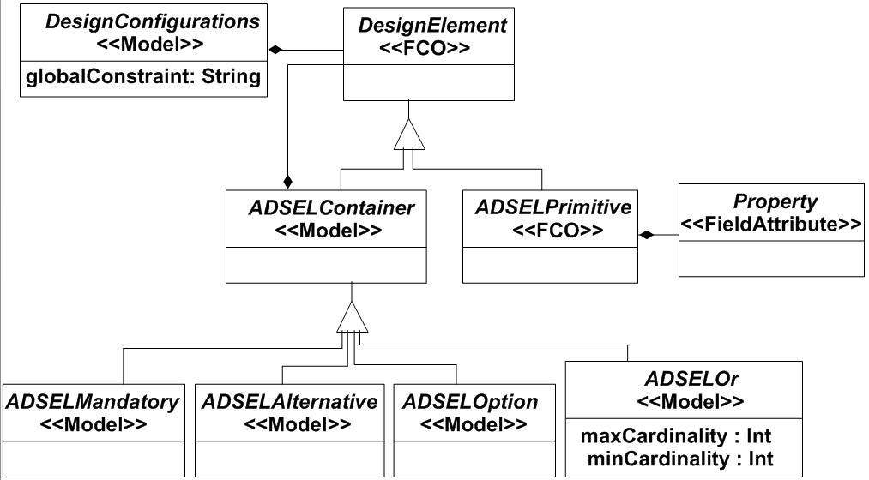
The ADSEL Component types
PropertyType
ValueType
Domain
Composition Function
Notes:
Influenced by “feature models”. Uses a subset which is sufficient to capture generic structure of design spaces.
Properties: used in the evaluation of each design point. ADSEL allows association of DSE properties to the primitives and the property values of the container nodes is calculated using the composition function

Slide 17
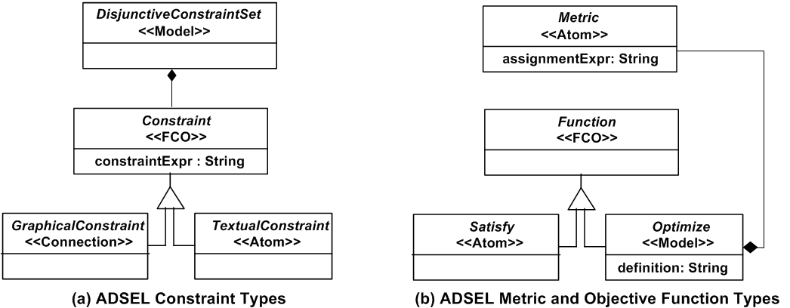
The ADSEL Constraint and Objective types
e.g. utilization
e.g. A.Sel -> not B.Sel
e.g. A.Memory <= 100
e.g.minimize (cost)
Notes:
Captures constraints on the design space using 2 constraint classes:

Slide 18
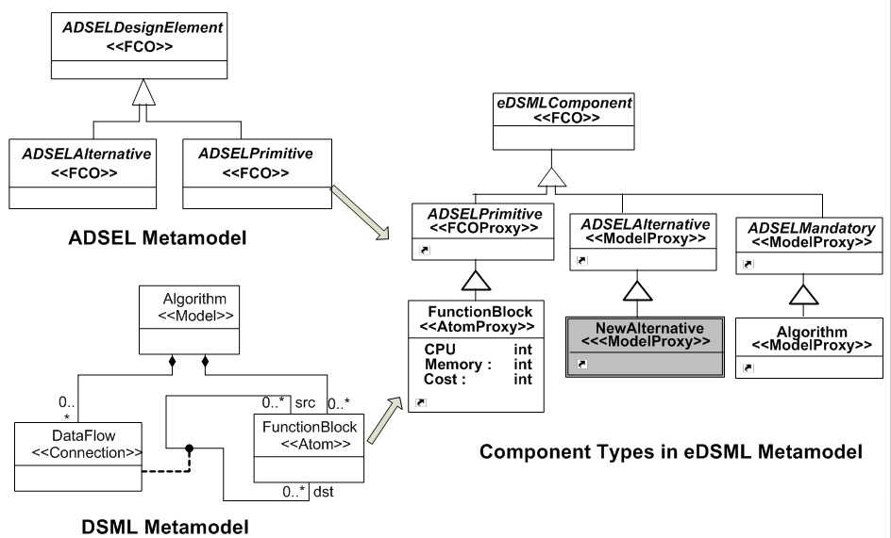
Metamodel Composition: Template Instantiation
Notes:
Template instantiation technique is used.
Composition is done by inheriting elements in the DSML from elements in ADSEL. This way they can play the roles of the template elements in the target DSML. This
This extended-feature metamodel is used to configure GME so that domain-engineers can create design space models with instances of constraints and objectives

Slide 19
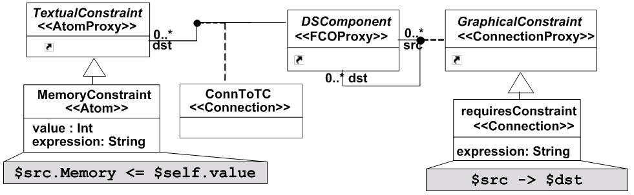
Metamodel Composition: Template Instantiation
Notes:
Template instantiation technique is used.
Composition is done by inheriting elements in the DSML from elements in ADSEL. This way they can play the roles of the template elements in the target DSML. This
This extended-feature metamodel is used to configure GME so that domain-engineers can create design space models with instances of constraints and objectives

Slide 20
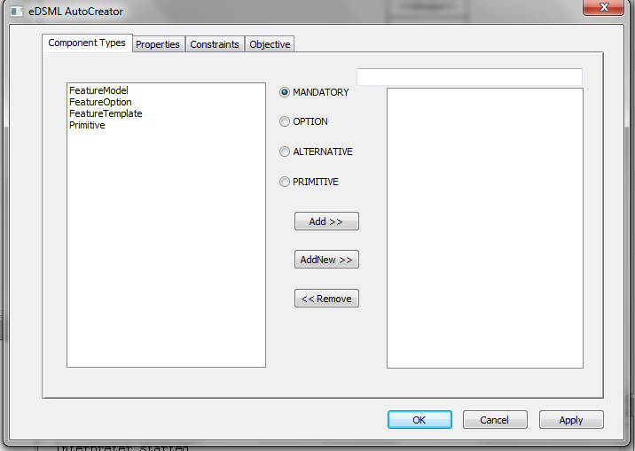
Composition Automation: eDSML Creator
GUI
Semi-Automated Metamodel Creation based on user selection
Written in C++

Slide 21
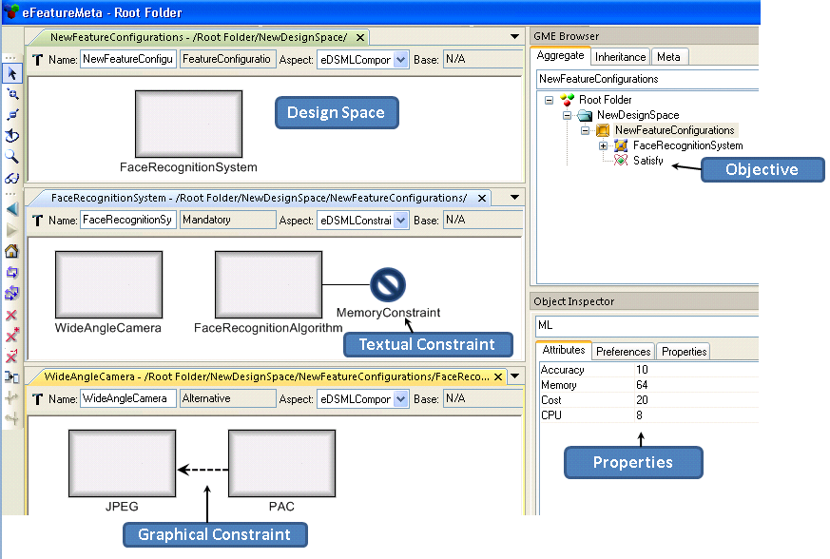
Step 3: Create Instance Model
NA
NA
M

Slide 22
Step 4: Perform DSE
GME
DSML
1
ADSEL
GME
4
Model Transformation
Intermediate Language
2
eDSML
Instance of
Instance of
Intermediate Design Space Model
DESERT
Design Space Model
t
3
Solver Independent Constraint Problem in Minizinc
FlatZinc Solver
LP Solver
FD Solver
Gecode
Solver
Notes:
Intermediate Language
Minizinc: is a medium level language which is used for specification of combinatorial search problems. The minizinc tool distribution includes a set of pre-defined translators that can translate the minizinc model to ILP, SAT, CSP etc.

Slide 23
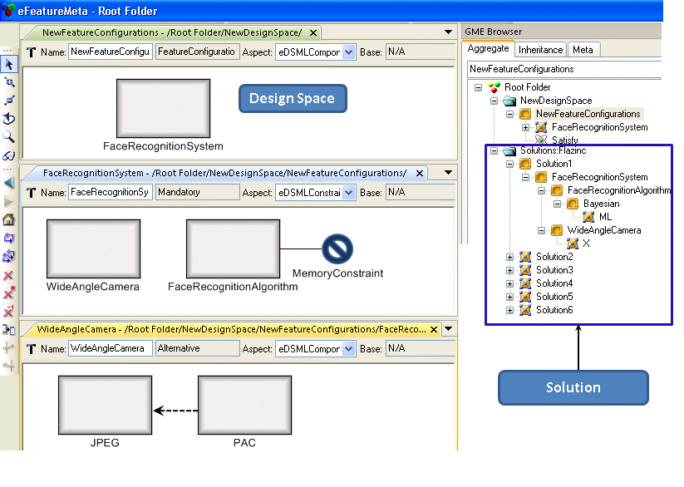
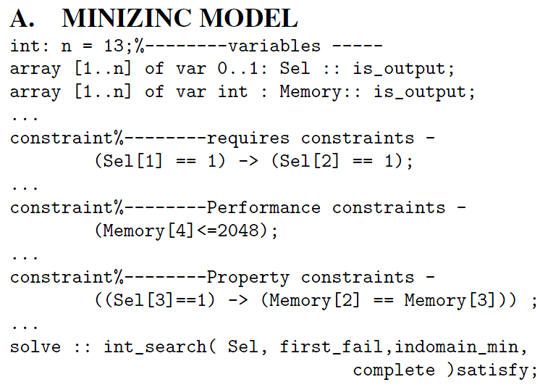
Solutions
Solver Selection
Solver

Slide 24
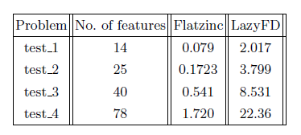
Summary
A Generic Framework
Reusable
Flexible
Case studies from different domains
Software Product Line Configuration
Architecture Synthesis
Hardware Software Co-synthesis
Scalability: SPLE

Slide 25
Conclusion
Other use cases
Hybrid Tool: Invoke multiple solvers in series
Scalability Analysis Tool
Future Work
Wider range of case studies
Support parametric representation
Support algorithms for multi-objective optimization

Slide 26
Questions ?

