Slide 1
Measuring the Effort for
Creating and Using
Domain-Specific Models
Yali Wu
PhD Candidate
18 October 2010

Slide 2
Outline
Introduction
Related Work
Motivation
Contributions
Effort classification
Effort Metrics
Applying Metrics
Conclusion

Slide 3
Introduction
DSMLs lead to increased productivity through domain specific abstractions¹
Industrial experiences have shown DSMLs to be 5-10 times more productive¹
Is there a systematic approach of measuring the claimed benefits of using DSMLs?
1: www.dsmforum.org
Notes:
Put the reference

Slide 4
Related Work
Current ways of measuring DSM productivity
  Qualitative results as anecdotal evidence
  Measuring reduced development time
  Measuring reduced implementation effort
Software model metrics
  Model heterogeneity created challenges
  Initially focus on model size
Notes:
While reduced development time is the most simple and intuitive way to measure productivity, this approach ignores the fundamental nature of domain specific modeling process: the manipulation of models. Sometimes, we want more course-grained measurements as opposed to time.

Slide 5
Motivation
How do we systematically measure the effort involved in domain specific modeling in a way that:
  Take into concern the multiple dimensions of the DSM process?
  Does not depend on specific DSMLs?

Slide 6
Contributions
A classification of the effort involved in realizing applications using DSMLs
A set of metrics for measuring each category of the involved effort
A case study showing how these metrics could be applied to various DSMLs

Slide 7
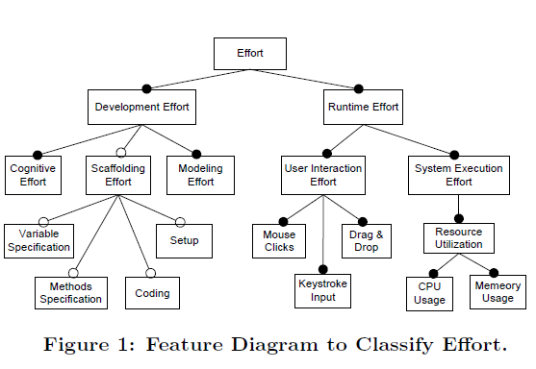
Effort Classification

Slide 8
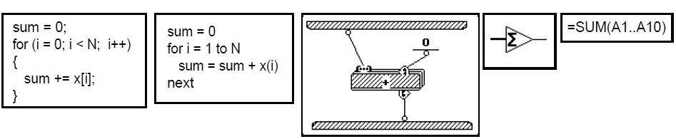
Development Effort
Effort Category | Effort Metrics | Explanation | Associated Property
Modeling Effort | Size Of Model | Effort required to create the model | Conciseness
 | Control Flow Complexity
Cognitive Effort | Cognitive Weight | Effort required to form mental solutions to problems | Understandability Comprehensiveness
 | Closeness of Mapping
Scaffolding Effort | Addt. LOC | Additional effort required to create complete solutions to produce executables | Executablility
 | Addt. Methods
 | Addt. Vars
 | Addt. Components
LOC Metric
McCabe Metric
Cognitive Complexity
Usability Analysis

Slide 9
Runtime Effort
Effort Category | Effort Metrics | Explanation | Measured Property
User Interaction Effort | # Mouse Clicks | Effort required to interact with the execution interface | Runtime Ease-Of-Use
 | # Keyboard Input
 | # Drag’n’Drop
System Execution Effort | CPU Utilization | Required system resource to map to executables at runtime | Runtime Resource Efficiency
 | Memory Utilization

Slide 10
Applying Metrics to DSMLs
Model the same heathcare scenario using three different DSMLs
  Yet Another Workflow Modeling Language [W.M.P. van der Aalst, 2005]
  Windows Workflow Foundation[Microsoft 2010]
  Workflow Communication Modeling Language [Wu et al. 2010]
Collect metrics for realizing the DSML model
Notes:
Put the name of author and year for each of the DSML
WF-CML go last!
Explain the differences in the three languages
Aim not to evaluate the languages but to use them to illustrate the effort metrics

Slide 11
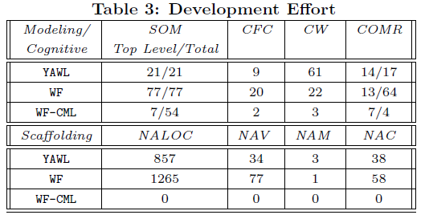
Results

Slide 12
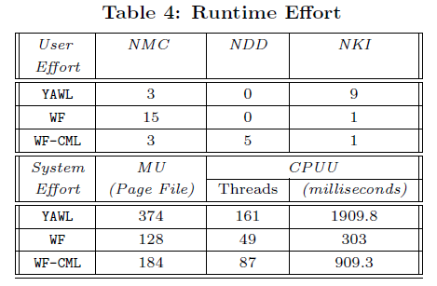
Results -cont

Slide 13
Discussions
An initial attempt towards quantitative measurement of effort in using DSMLs
Need more empirical studies to validate the metrics presented
  Survey more DSMLs
  Conduct extensive user studies for validation

Slide 14
Conclusion
Investigate the mesurement of the effort to realize applications using DSMLs
Present a classifcation of the effort and propose metrics for each category
Multi-dimensional measurement provides a systematic and quantitative way of measuring the productivity of DSMLs

Slide 15
Thanks!
谢谢!
Gracias!
Merci!
So which language requires less effort using the metrics presented?

