Slide 1







A WYSISYG Approach for Configuring Model Layout using Model Transformations
Yu Sun | University of Alabama at Birmingham
Jeff Gray | University of Alabama
Philip Langer | Johannes Kepler University Linz
Manuel Wimmer | Vienna University of Technology
Jules White | Virginia Tech
The 10th Workshop on Domain-Specific Modeling
Reno, Nevada, USA
October 17th, 2010
This research is supported by
NSF CAREER award CCF-1052616

Slide 2
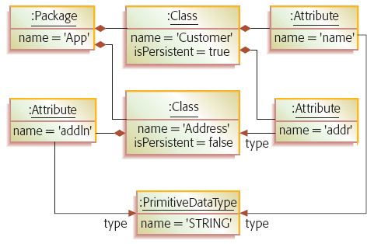
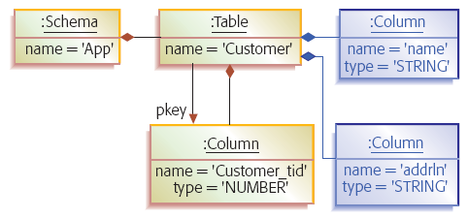
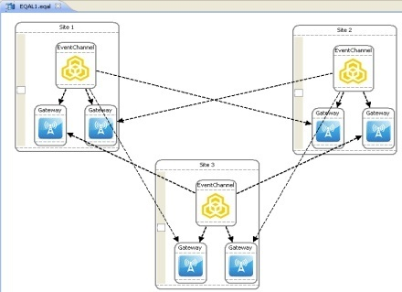
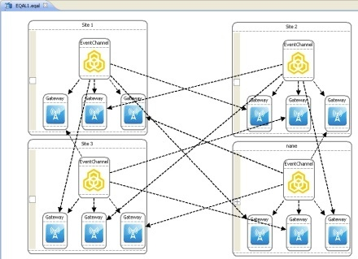
Model Transformation
Model transformation has been well-supported in different modeling tools
Exogenous Model Transformation
Endogenous Model Transformation
Metamodel1
Metamodel2
Metamodel1
Model1
Model2
Model
Model’

Slide 3
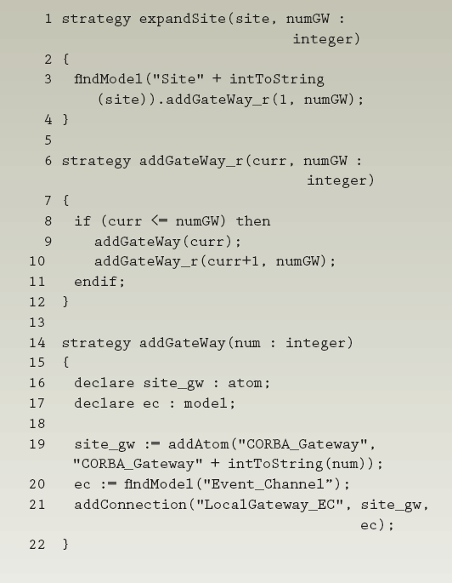
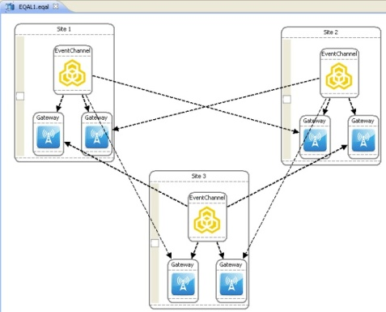
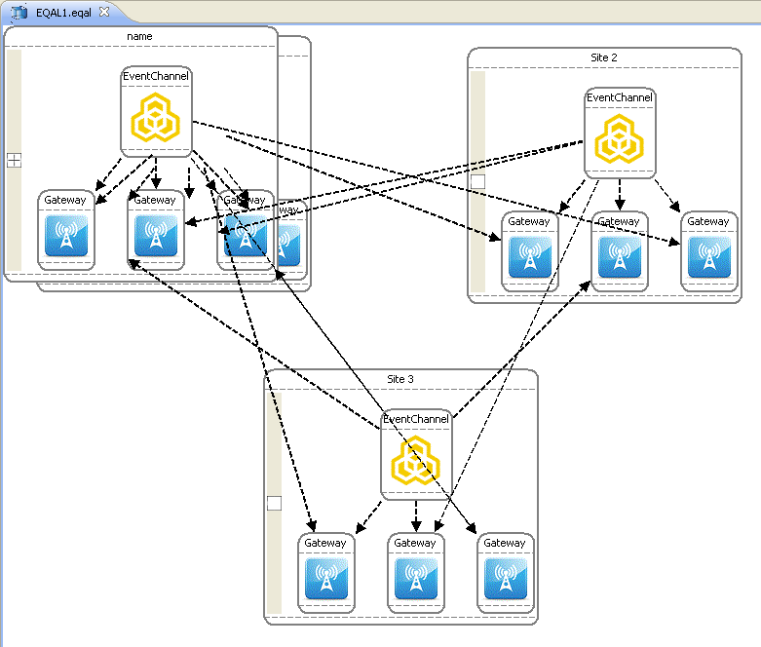
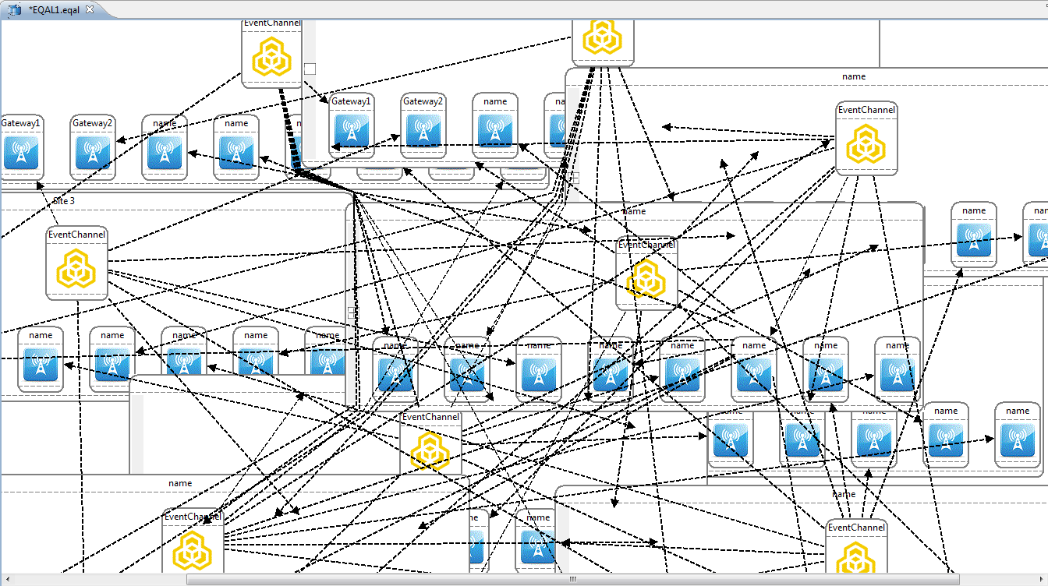

Layout Configuration in Model Transformation
The configuration layout is often ignored in model transformations

Slide 4
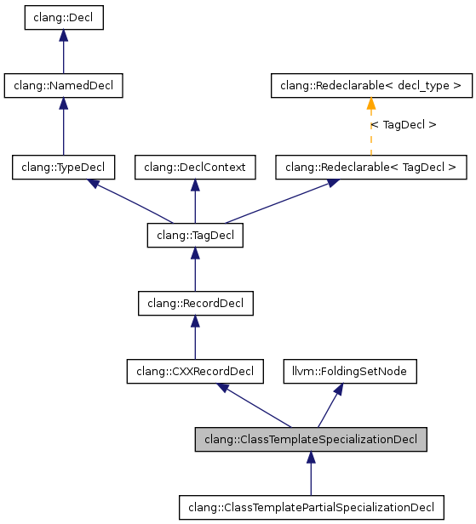
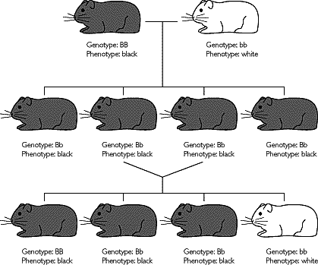
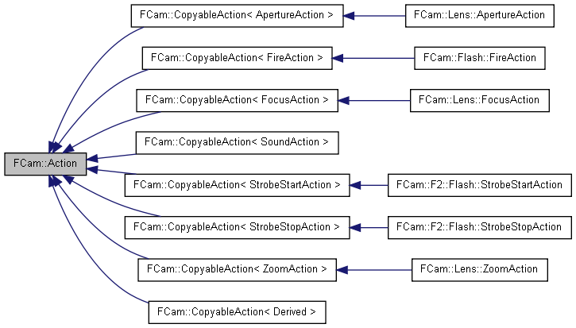
Challenges from Ignoring Layout Configuration
Poor readability
Loss of implicit semantic context
Reduction in a user’s mental map

Slide 5
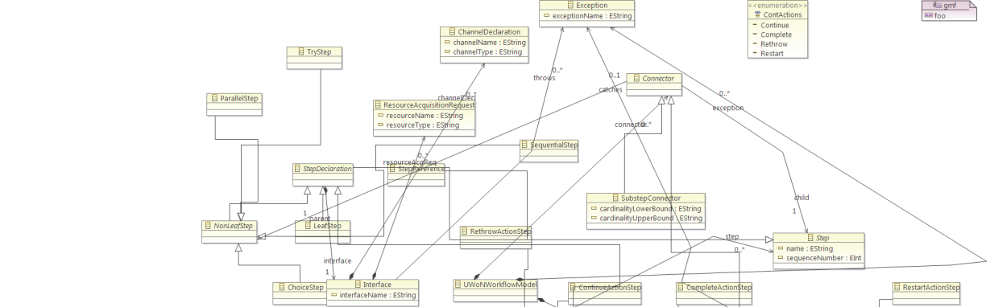
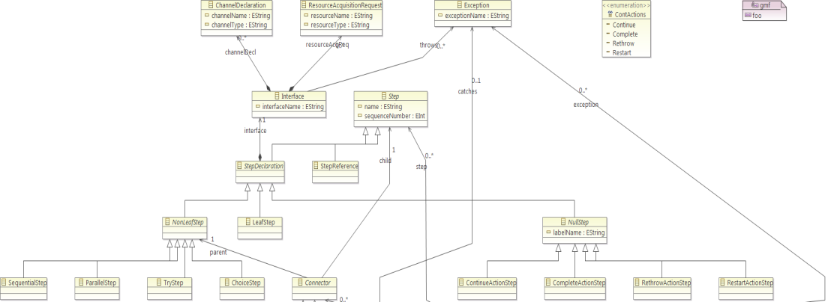
Using Automatic Layout Algorithms
Automatic layout arrangement functionality is available in a number of modeling tools
Remove overlaps
Group elements
Implicit semantic issues
Limitations
Not all semantics issues
Does not support mantel maps
Hard to customize

Slide 6
Specify Layout in Model Transformation Rules
curr.setX();
curr.setY();
site_gw.setSize();
site_gw.setY();
Creates potential crosscutting and tangled concerns
Not convenient to test and debug
Challenging to learn model transformation languages

Slide 7

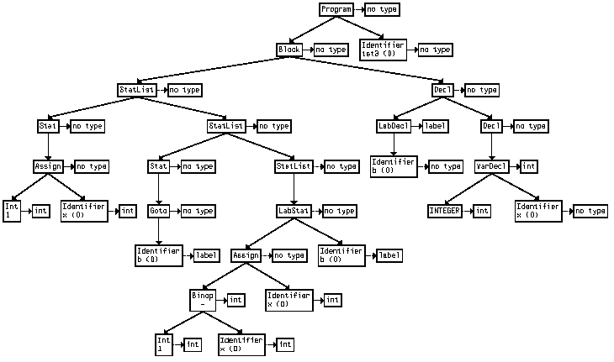
The Desired Approach to Configure Layout in MT
Enable users to flexibly customize the layout in MT and to realize the desired implicit semantics and mental maps
The layout configuration can be clearly separated from the original MT
Easy to test and debug the result
Easy to learn and use

Slide 8
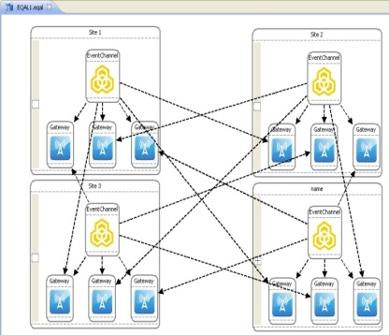

Solution: Layout Configuration By Demonstration
An extension to Model Transformation By Demonstration
A model transformation approach to enable users to implement model transformations without using model transformation languages and knowing metamodel definitions
Demonstrate layout configuration on a concrete example in a WYSIWYG way, and generate the transformation pattern to carry out the layout configuration automatically

Slide 9
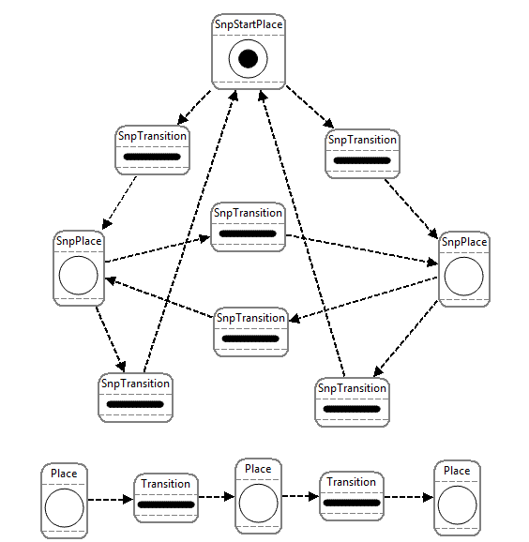
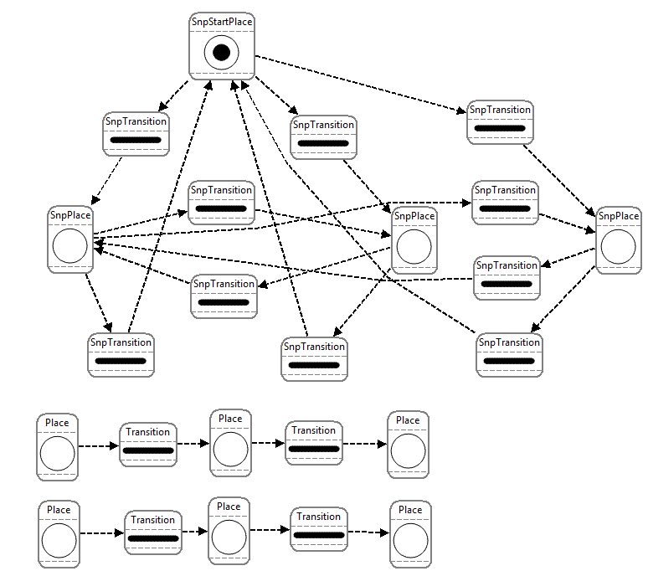
Demo: Scaling SRN Model
Stochastic Reward Nets (SRNs) model can be used for the evaluation of reliability for complex systems
A SRN model needs to be scaled up to adapt the addition of new events and types

Slide 10
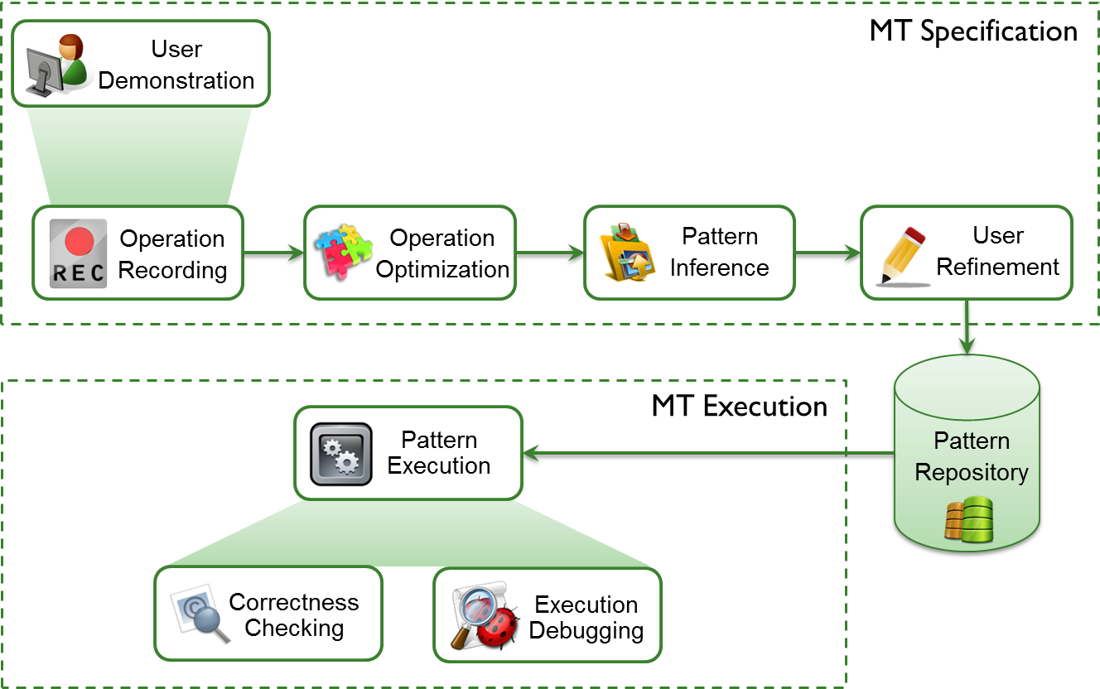
Overview of MTBD

Slide 11

Layout Extension to MTBD
Demonstrate Layout Configuration

Slide 12
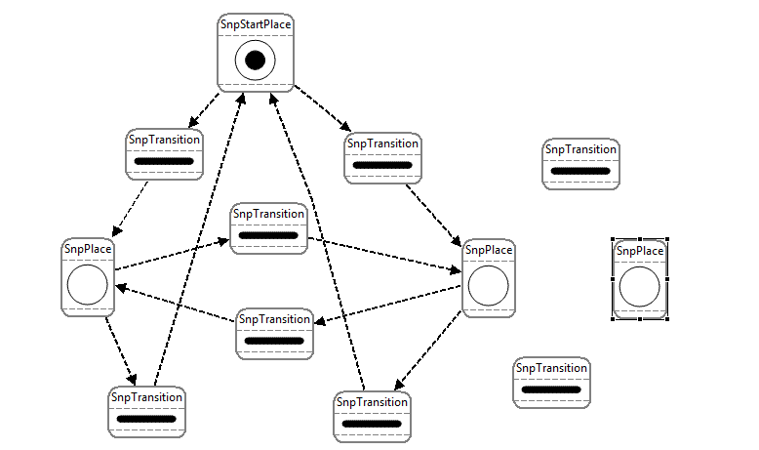
Extending MTBD to Configure Layout
Using Absolute Coordinates
Set X as Current
Set Y as Current
Automatically retrieve the value and generate a command attached to the transformation pattern

Slide 13
Extending MTBD to Configure Layout
Using Relative Coordinates
Set X relative to Leftmost
Set X relative to Rightmost
Set Y relative to Uppermost
Set Y relative to Bottommost
Automatically retrieve the relative value and generate a command attached to the transformation pattern

Slide 14

Summary
Users can customize the layout configuration to realize desired semantics and mental maps
Layout can be separated from the original transformation by performing the demonstration separately
WYSIWYG style helps to test and debug the configuration
No model transformation is used, easy to learn and use

Slide 15

Future Work
Realize more types of customization
Relative to certain model element(s)
Relative to a certain substructure of a model
Relative to the inside of the model boundary
Configure the Font, Size, Color, etc.

Slide 16

Thank You
Questions and Comments?
Additional questions
yusun@cis.uab.edu
This research is supported by
NSF CAREER award CCF-1052616
Model Transformation By Demonstration

