Slide 1

Plug & Play Model Transformations – A DSL for Resolving Structural Metamodel Heterogeneities*
M. Wimmer, A. Kusel, G. Kappel, W. Retschitzegger, J. Schönböck, and W. Schwinger
10th Workshop on Domain-Specific Modeling, Reno, Nevada, USA
Johannes Schönböck
*This work has been partly funded by the Austrian Science Fund (FWF) under grant P21374-N13.

Slide 2

Introduction
Introduction
Motivation
MOps
Evaluation
Future Work
Transformation languages are an essential prerequisite in MDE
Key challenge: resolution of recurring structural heterogeneities (resulting from applying different modeling constructs for expressing one semantic concept)
TechReport
Publication
name:String
kind=‘TechReport’
university:String
name:String
Split the
object set
kind:String
university:String
ConfPublication
location:String
kind=‘ConfPublication’
name:String
location:String
LHS MM
RHS MM

Slide 3
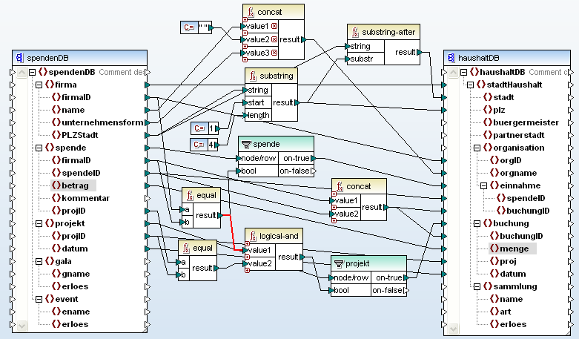
Motivation
Introduction
Motivation
MOps
Evaluation
Future Work
Advantages:
  Abstraction from code
  Transformation logic reuse by predefined components
  Reduction of specification overhead
  Platform independence – mapping can be executed by diverse transformation languages
Currently model transformation languages are used to
overcome structural heterogeneities
Transformation languages
  Miss appropriate reuse facilities, i.e., predefined, configurable patterns
  Force the transformation designer to deal with low-level intricacies of a certain language, i.e., miss abstraction facilities
Our approach: Application of abstract mappings
  Specified on the basis of reusable components,
  called mapping operators (MOps)
  Each MOp allows to resolve a certain kind of structural heterogeneity
  Each MOp is typed to the core concepts of meta-metamodels,
  i.e., EClasses, EAttributes and EReferences, thereby achieving metamodel independence

Slide 4
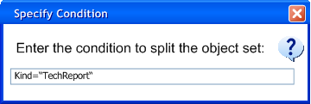
Composite MOps – Blackbox View
Introduction
Motivation
MOps
Evaluation
Future Work
Composite MOps provided for typical structural heterogeneities
High-level black-box mapping view to map classes only
Composite MOps consist of
  Kernel MOps providing necessary expressivity
  Additional Composite MOps
TechReport
Intention: split the object set
Publication
kind=‘TechReport‘
name:String
university:String
name:String
Splitter
C
kind:String
C
university:String
kind=‘ConfPub‘
ConfPublication
location:String
name:String
location:String
LHS MM
RHS MM

Slide 5
Kernel MOps
Introduction
Motivation
MOps
Evaluation
Future Work
Are the basic building blocks of each mapping
Provide expressivity for specifying model transformations, i.e., being a minimal set of required MOps to overcome structural heterogeneities
Provided for
  Copying
  Merging
  Generating
Concept | Copying | Merging | Generating
Class (2ClassMOps)
Attribute (2AttributeMOps)
Relationship (2RelationshipMOps)
C C
C
Cn C
C
0 C
C
C
2
C
2
2
T
T
T
C
C
C
A A
A
An A
A
0 A
A
A
2
A
2
2
C
C
C
R R
R
Rn R
R
0 R
R
2
R
C
2
2
R
C
C
* Note that splitting can be represented by several copying MOps

Slide 6
Composition of Kernel MOps
Introduction
Motivation
MOps
Evaluation
Future Work
Splitter
Splitter consists of
  [2..*] Copiers
C
Copier
C
C
C
...
C
Copier
C
C
Copier consists of
  [1] C₂C
  [0..*] 2AttributeMOps
  [0..*] 2RelationshipMOps
Fixed Part of the Composite MOp
⇨ Gets pre-generated when applying the MOp
Copier
Variable Part of the Composite MOp
⇨ Matching strategies or user-defined
cl
C C
cl
C
C
2
C
C
T
attr [*]
C
attr [*]
A
A
2
AttributeMOp
[*]
A
A
ref [*]
C
ref [*]
R
R
2
RelationshipMOp
[*]
R
R
C
C
T

Slide 7
Composite MOps – Whitebox View
Introduction
Motivation
MOps
Evaluation
Future Work
Copier consists of a fixed, automatically generated class mappings
and optional attribute and relationship mappings,
partly generated by matching strategies
Splitter contains Copier Composite MOps, which are automatically derived from the class binding in the black-box view
Splitter
TechReport
Publication
kind=‘TechReport‘
name:String
C
Copier
C
university:String
name:String
kind=‘TechReport‘
Splitter
C
kind:String
C
C C
C
C
2
university:String
C
T
kind=‘ConfPub‘
ConfPublication
location:String
A A
A
A
A
A
2
C
name:String
A A
A
A
A
A
2
location:String
LHS MM
Copier
C
RHS MM
kind=‘ConfPub‘
C C
C
C
2
T
C
A A
A
A
A
A
2
C
A A
A
A
A
A
2
Generated
User-defined

Slide 8
iMOps – MOps dealing with Inheritance
Introduction
Motivation
MOps
Evaluation
Future Work
Inheritance heavily used in Metamodels
  Without inheritance between mapping, redundancy results
Inheritance between Mops
  Submapping inherits the feature mappings of a supermapping
  Submappings may refine the supermapping (add or override)
  Inheritance between MOps is only allowed iff
    Classes of the supermappings and the submappings are in an inheritance relationship in the MM or
    All mappings have the same LHS class as input

Slide 9
Composite MOps – Inheritance
Introduction
Motivation
MOps
Evaluation
Future Work
Intention: inheritance hierarchy instead of an attribute
Splitter
Attribute2Inheritance
Abstract Copier
C
C C
C
C
2
T
C
A A
A
A
A
A
2
Publication
Publication
name:String
Copier
C
name:String
C
kind=‘TechReport‘
kind:String
C C
C
C
2
university:String
C
T
TechReport
location:String
A
A A
A
Redundant Specification
A
A
2
C
university:String
A A
A
A
A
A
2
Copier
C
C
kind=‘ConfPub‘
ConfPublication
C C
C
C
2
location:String
T
C
A A
A
A
A
A
2
C
LHS MM
A A
A
A
RHS MM
A
A
2
Generated
User-defined

Slide 10
Composite MOps – Inheritance
Introduction
Motivation
MOps
Evaluation
Future Work
Diverse patterns might occur, when one MM uses inheritance whereas the other one does not
  Represent well-known patterns from the area of object-relational transformations and refactorings
iMOp | Description | Known Uses
A₂I (Attribute2Inheritance) | LHS MM encodes type information by attribute values; RHS MM provides explicit types in an inheritance hierarchy | Replace Type Code with Subclasses One Inheritance Tree One Table
I₂A (Inheritance2Attribute) | LHS MM provides explicit types in an inheritance hierarchy; RHS MM encodes type information by attribute values | Replace Subclass with Fields One Inheritance Tree One Table
Publication
Publication
Attribute2Inheritance
name:String
name:String
kind:String
university:String
Inheritance2Attribute
ConfPublication
TechReport
location:String
location:String
university:String

Slide 11
Composite MOps – Inheritance
Introduction
Motivation
MOps
Evaluation
Future Work
iMOp | Description | Known Uses
R₂I (Reference2Inheritance) | LHS MM relates classes by references; RHS MM provides an explicit inheritance hierarchy | Replace Delegation with Inheritance One Class One Table
I₂R (Inheritance2Reference) | LHS MM provides explicit inheritance hierarchy; RHS MM relates classes by references | Replace Inheritance with Delegation One Class One Table
1
Publication
1
name:String
Publication
name:String
publication
Reference2Inheritance
TechReport
university:String
Inheritance2Reference
ConfPublication
TechReport
publication
location:String
university:String
ConfPublication
location:String

Slide 12
Composite MOps – Inheritance
Introduction
Motivation
MOps
Evaluation
Future Work
iMOp | Description | Known Uses
C₂I (Class2Inheritance) | Independent LHS MM classes are contained in an inheritance hierarchy in RHS MM | Extract Superclass One Inheritance Path One Table
I₂C (Inheritance2Class) | LHS inheritance hierarchy is represented by independent RHS classes | One Inheritance Path One Table
TechReport
name:String
Publication
university:String
name:String
Class2Inheritance
Inheritance2Class
ConfPublication
TechReport
ConfPublication
location:String
university:String
name:String
location:String

Slide 13
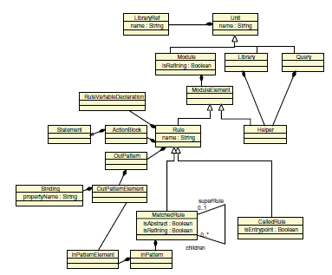
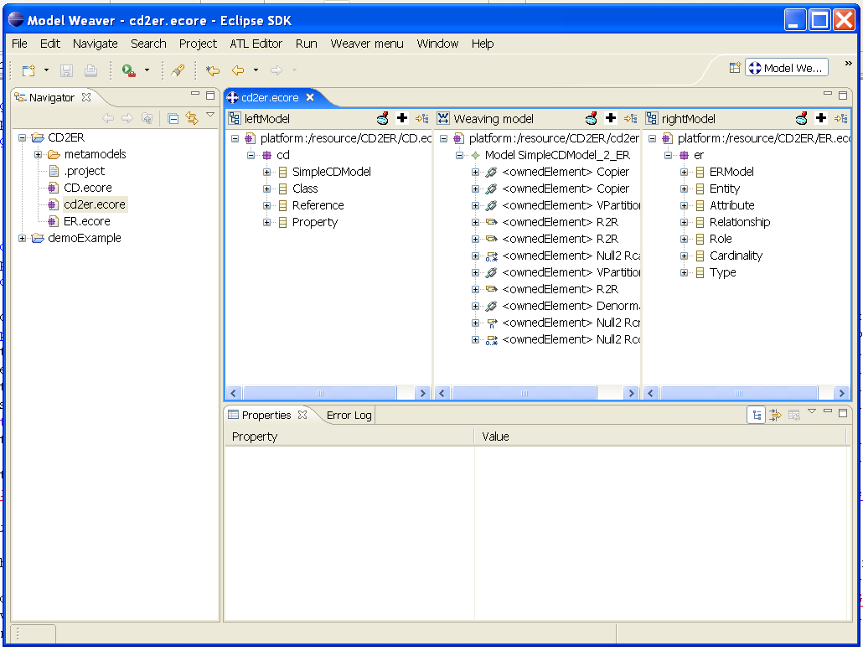
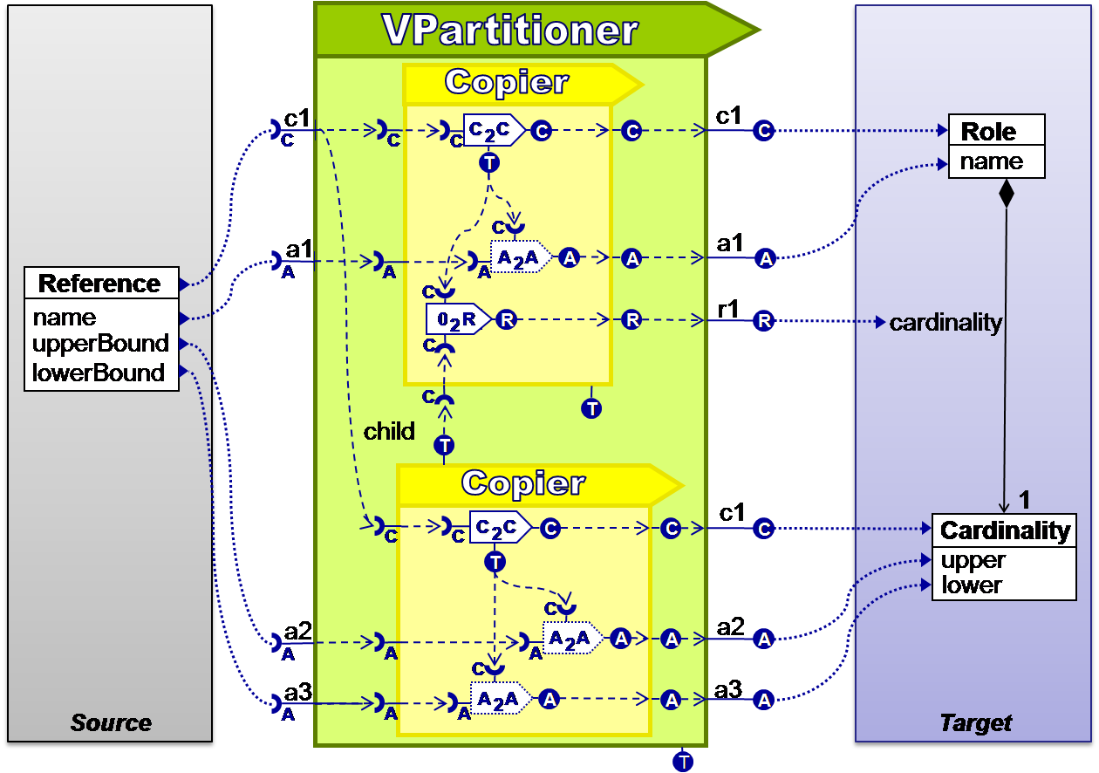

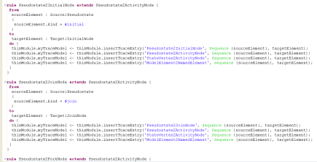
Implementation
Introduction
Motivation
MOps
Evaluation
Future Work
Platform-independent Model
Platform-dependent Model
AMW Editor
MOps MM
ATL MM
implements
Trafo
produces
instance of
instance of
Executable
ATL Code
Source MM
Target MM
Mapping

Slide 14
Evaluation –
ActivityDiagram Migration Case Study of TTC 2010
Introduction
Motivation
MOps
Evaluation
Future Work
Top-Level Composite MOps | Number | Percentage
Copier | 4 | 44,4 %
VPartitioner | 1 | 11,1 %
A₂I | 1 | 11,1 %
I₂I | 1 | 11,1 %
VMerger | 2 | 22,2 %
Total | 9 | 100 %
Kernel MOps | Number | Percentage
C₂C | 14 | 41,2 %
Cn₂C | 2 | 5,9 %
0₂A | 1 | 2,9 %
A₂A | 5 | 14,7 %
0₂R | 2 | 5,9 %
R₂R | 10 | 29,4 %
Total | 34 | 100 %
3 (8,8 %)
Migration of UML Activity Diagrams from Version 1.4 to 2.2
  # LHS classes: 15
  # RHS clases: 17
2 (5,9 %)
29 (85,3 %)

Slide 15
Evaluation –
ActivityDiagram Migration Case Study of TTC 2010
Introduction
Motivation
MOps
Evaluation
Future Work
Top-Level Composite MOps | Generated elements | User-defined elements (despite nested composite MOps and arcs)
4 Copier | 4 C2Cs, 1 A2A, 3 R2Rs | 1 R2R
1 VPartitioner | 2 C2Cs, 1 A2A, 1 R2R | 3 R2Rs, 1 02A, 2 02Rs, 1 Function, 1 Condition
A₂I | 5 C2Cs | 5 Conditions
I₂I | 3 C2Cs | -
VMerger | 2 Cn2Cs, 3 A2As, 2 R2Rs | -
Total (Kernel MOps) | 27 | 7

Slide 16
Future Work
Introduction
Motivation
MOps
Evaluation
Future Work
Introduction of new composite MOps
  Conduct several larger case studies
  Introduce new composite MOps for newly occuring situations
Validation of Mappings
  Enhance basic validation support currently basing on the MOps MM only
  Usage of OCL constraints
Enabling Interactive Guidance
  Introduce interactive guidance in two ways
    Guidance „in the small“ by guiding the application of a certain MOp
    Guidance „in the large“ by guiding the specification of a whole mapping
Debugging of Mappings
  Currently ATL supported as execution language, introducing an impedance mismatch between specification and execution
  Other transformation languages as TROPIC should be investigated

Slide 17
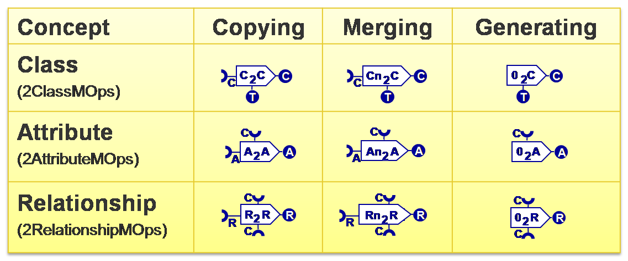
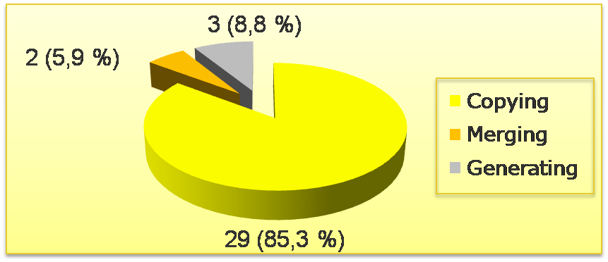

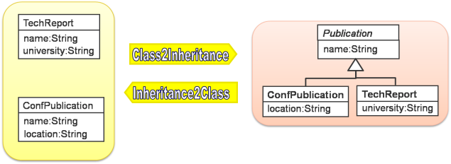
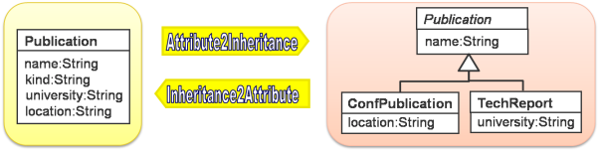
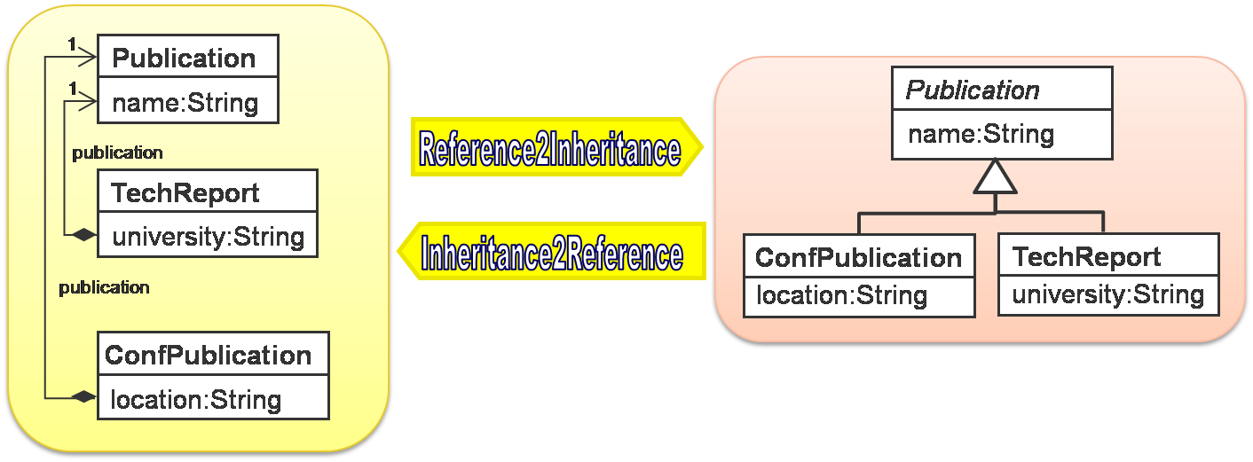
Thank you for your attention!
http://www.modeltransformation.net

