Slide 1
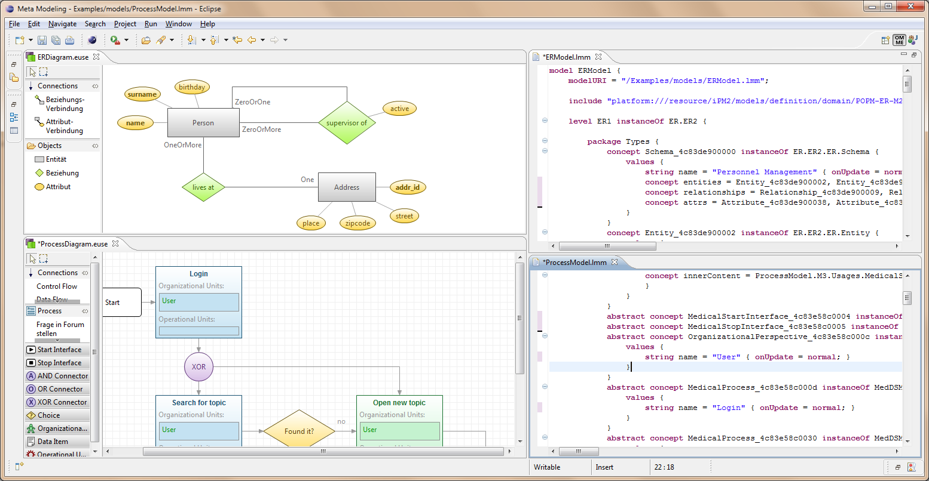
Towards an Open Meta Modeling Environment

Slide 2
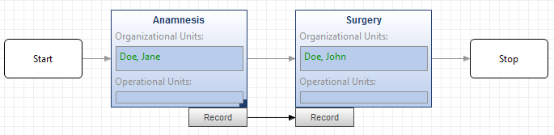
Main Business: Process Management
Administration
Tourism
Scientific
Workflows
Clinical Pathways
Entity Relationship Model,
Static Structure of Classes,
Transformation description, …
Modeling Construct
Functional Perspective
Data and Data-Flow Perspective
Complex assignment strategies and constraints (rules, evaluation of performance, …)
Organizational Perspective
Operational Perspective
Dynamic Execution based on complex constraints vs. Strict Execution (BPEL, …)
Behavioral Perspective
…
Performing changes on modeling languages and execution frameworks is a daily business and not an exception! Thus, the pragmatics of performing constant model evolution is a key topic in our research!

Slide 3
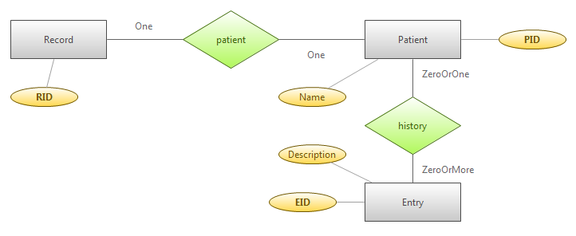
Thus we need to …
Connect and integrate models of different nature
  Process Model with Data Models
  Process Model with Organizational Model
  …
Be able to define constraints for
  Validating models
  Controlling the execution of a process
  …

Slide 4
Thus we need to …
Connect and integrate models of different nature
  Process Model with Data Models
  Process Model with Organizational Model
  …
Be able to define constraints for
  Validating models
  Controlling the execution of a process
  …
Create new and adapt existing modeling languages
  Deletion of modeling constructs is allowed
  Definition of Graphical and Textual syntax

Slide 5
Thus we need to …
Connect and integrate models of different nature
  Process Model with Data Models
  Process Model with Organizational Model
  …
Be able to define constraints for
  Validating models
  Controlling the execution of a process
  …
Create new and adapt existing modeling languages
  Deletion of modeling constructs is allowed
  Definition of Graphical and Textual syntax
„Simulation of instances”
Entity
attrs
1..*
Attribute
M2
M1
<<instanceOf>>
<<instanceOf>>
Customer
<<MAssignment>>
Name
name
1
M1
M0
<<instanceOf>>
<<instanceOf>>
customer
"Otto"

Slide 6
Solution: We use Meta Modeling
Key concepts
  Orthogonal Classification
  Clabjects
Idea behind the LMM
  Structures to persist models, no semantics
  Model = Set of meta levels
Linguistic Meta Model
L1
L0
M3Type
M3Type
int a;
int a;
M3
M2
<<instanceOf>>
<<instanceOf>>
Logical: M2Type
Clabject: M2Type
instance:M3Type
linguistic
<<instanceOf>>
a = 4711;
Instance-Facet
Type-Facet
a = 4711;
int b;
M2Type
int b;
M2
M1
<<instanceOf>>
<<instanceOf>>
instance:M2Type
instance:M2Type
b = 0x815;
b = 0x815;

Slide 7
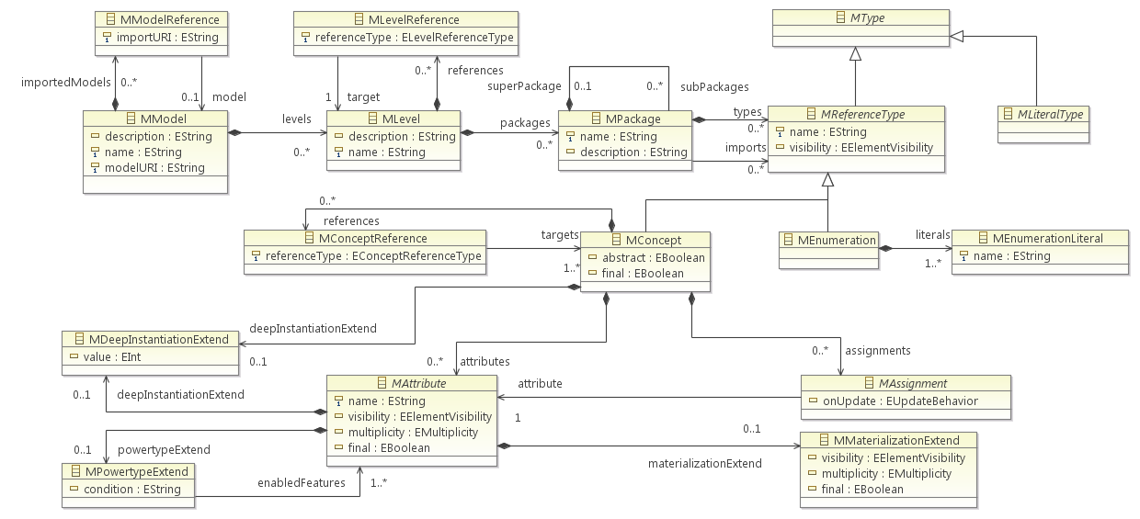
Linguistic Meta Model
2
1
3
4
Clabject = Concept
Deep Instantiation / Potency
Extended Powertypes
Materialization
Instance Specialization and Powertypes
  EConceptReferenceType.concreteUseOf
  EConceptReferenceType.partitions

Slide 8
Linking Models of Different Nature
Abstract Process Meta Meta Model (APM²M)
outputData
ER Meta Model
NodeKind
Node
Entity
Abstract Process Meta Model (APMM)
Domain Specific Process Meta Model (DSPMM)
Process
Process Model
Anamnesis
Record
ER Model
(„Schema“)
Process Instance
Population
(„Data“)
A_JohnDoe_1
JohnDoe
ER Stack comprises only 3 levels, Process Modeling Stack has 4
LMM can be compared to
  Byte Code (Java)
  Intermediate Language (.NET)
Entities of each model can be used within the other model
  Typed Link (linking by a qualified reference)
  Untyped Link (linking by a Fully Qualified Name)

Slide 9
OMME – Open Meta Modeling Environment
Prototypical Implementation
  Eclipse 3.6.1
  Xtext 1.0.1
  Based on EMF, GEF and Draw2D
Current status
  Modeling core (mostly) complete
  Dynamic features under construction
  Mainly technical issues
Tools, Utilities and Capabilities
Models, APIs and Internal Editors
Team Support
Model Repository
Model
Query
Model Transformation
Model Matching
Model Designer Framework
Graphical Model Editor
Textual
Model Editor
Low-Level
LMM API
Dynamic LMM API
Dynamic Constraint Engine
Linguistic Meta Model
(LMM)
Java-Bean Mapping
Graphics
Editor
EMF / Ecore

Slide 10
Thank You For Your Attention!

