Slide 1
Domain-specific Modeling as an Enabling Technology for SMEs
Christian Schäfer
christian.schaefer@iese.fraunhofer.de

Slide 2
Content
Problem Description
Overall Language Development Approach
  Structure Modeling
  Anomaly Modeling
  Hardware Details
  Model Transformation & Code Generation
  Implementation Details
Summary

Slide 3

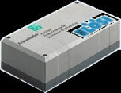
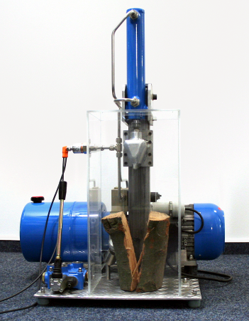
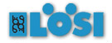





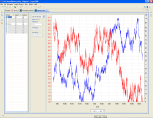
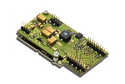
Problem Description
Condition Monitoring Systems
Data Acquisition
Pressure, viscosity, pollution, etc.
Manufacturer-independent sensors
Use of existing sensors
Data Evaluation
Continously at the facility
Detection / prediction of anomalies
Intervention in case of anomalies
Remote Maintenance
Remote supervision of facilities
Detailed data analysis
Intervention in case of anomalies occurrence
Data Transmission
  Data transmission via GPRS
  Transmission of measurement data
  Notification in case of anomalies occurrence

Slide 4
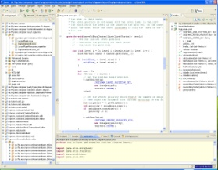




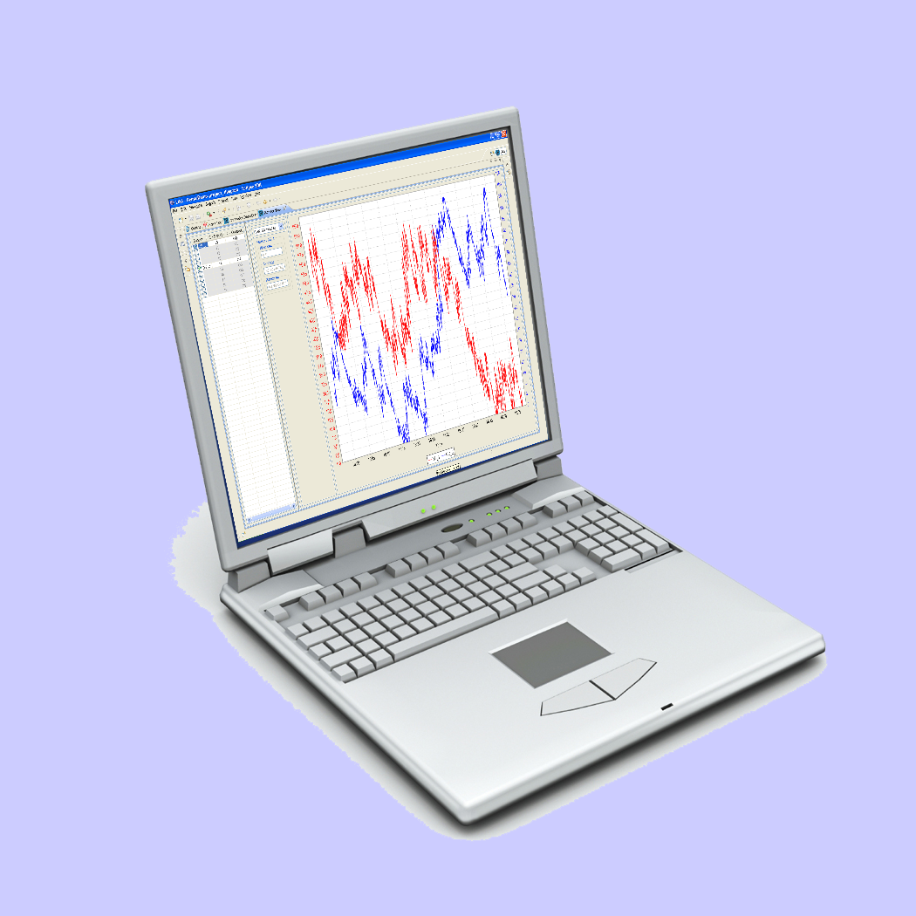
Traditional Solution
Manual Planning
of Customer Projects
Basic System
Manual Adaptation
(i.e. Programming)
Customer Project

Slide 5
Problems of the Traditional Solution
Manual extension / adaptation for each customer project
  High development time
  High development costs
  Very error-prone
Poor market opportunities

Slide 6
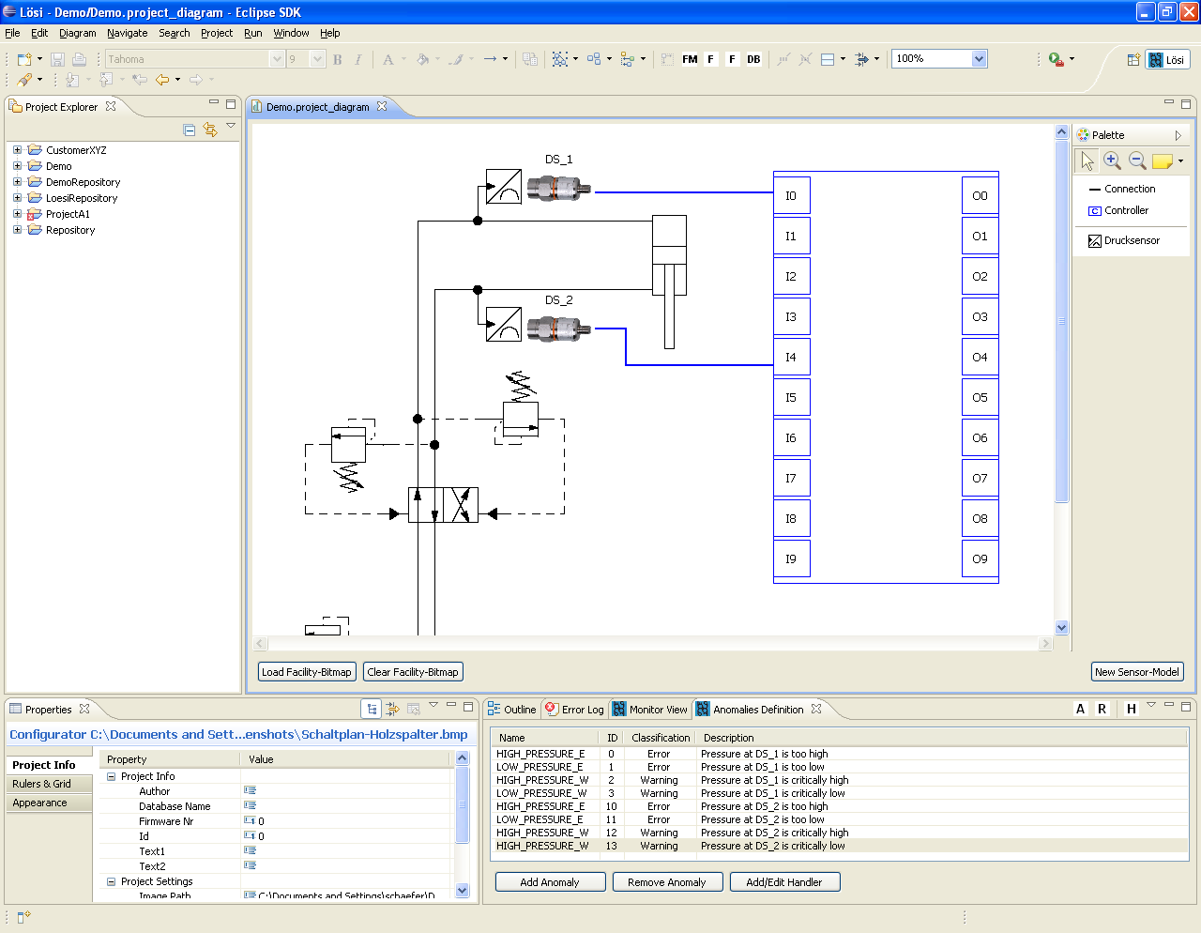
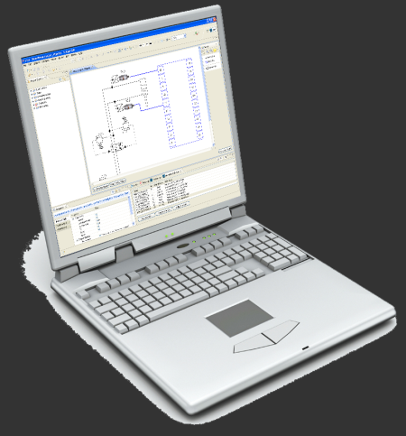

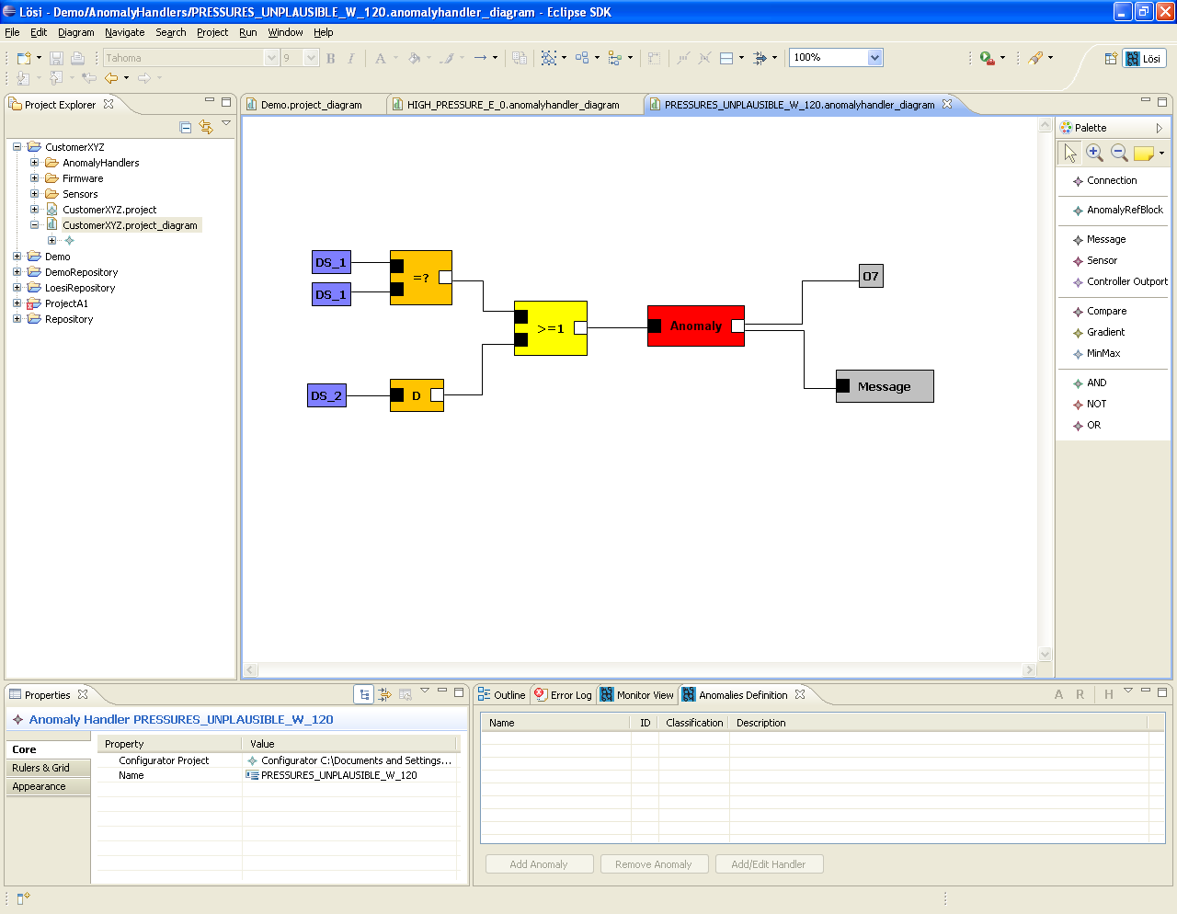
DSM Solution
2. Automatic code generation and -installation
1. Graphical configuration of the facility
3. Commissioning

Slide 7
Advantages of the DSM Solution
Intuitive, graphical configuration of the CM system
Automatic generation of customer projects
  No need for SW-Developers
  Short development times
  Low development costs
  High quality
Key advantages in the market

Slide 8

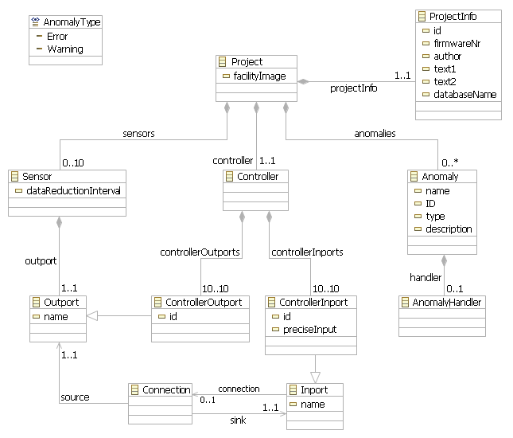
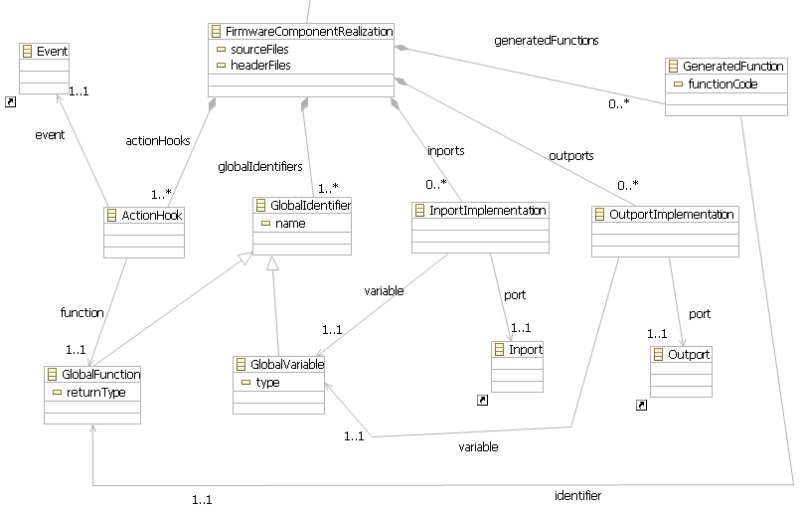
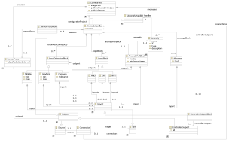
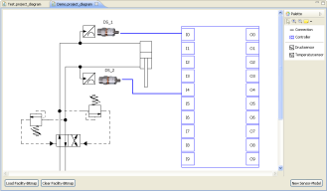
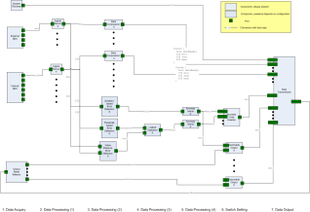
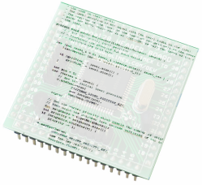

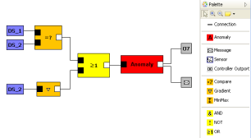
Overall Language Development Approach
Eclipse,
EMF + GMF
Component
Library
Templates
Structure
Meta-Model
Model-to-Model
Firmware
Meta-Model
Code
Generation
Framework
Anomaly
Meta-Model
Provided by us
Used by industry partner
Structure
Model
PIM-to-PSM
Firmware
Model
Code Generation
Deployment
Firmware
Anomaly
Models

Slide 9
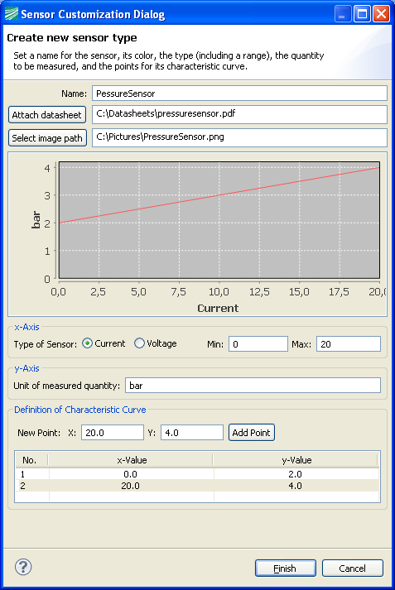
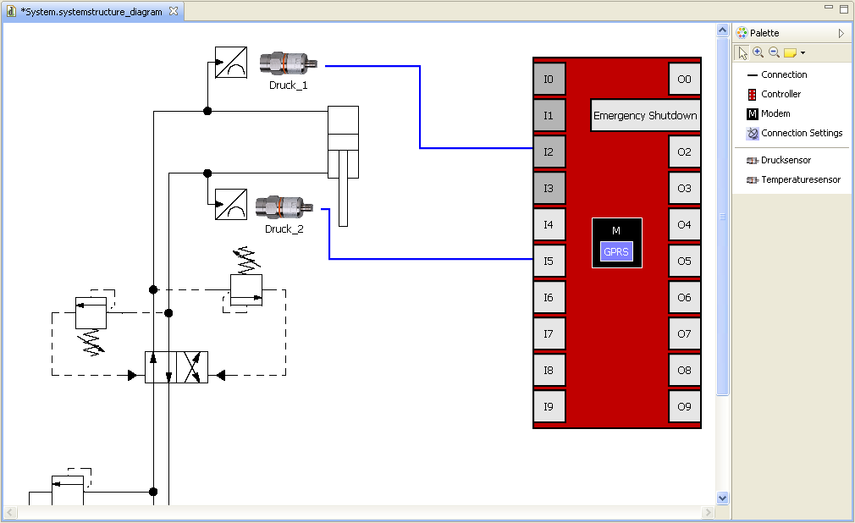
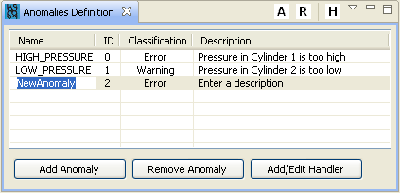
Structure Modeling

Slide 10
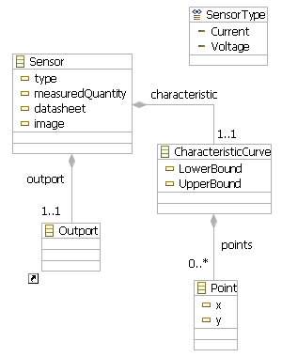
Structure Modeling – Metamodel

Slide 11
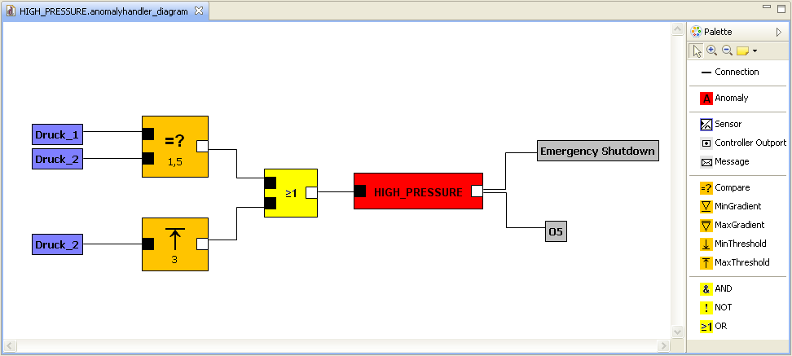
Anomaly Modeling
Sensor Data
Acquisition
Error
Detection
Logical
Combination
Anomaly
Evaluation
Reaction

Slide 12
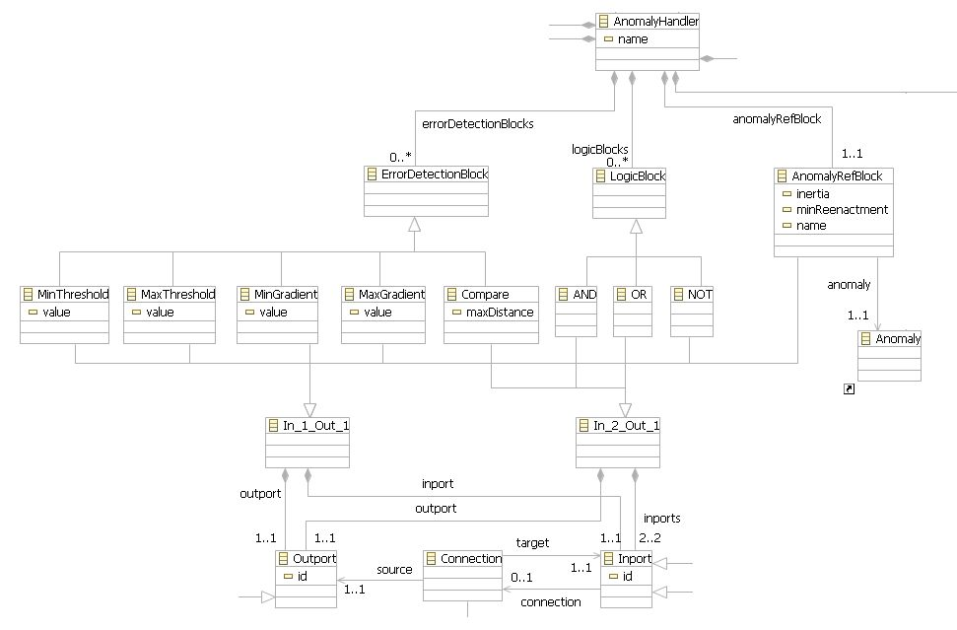
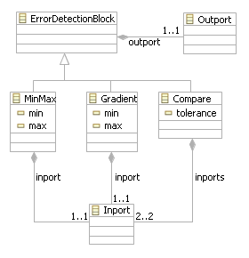
Anomaly Modeling – Metamodel

Slide 13
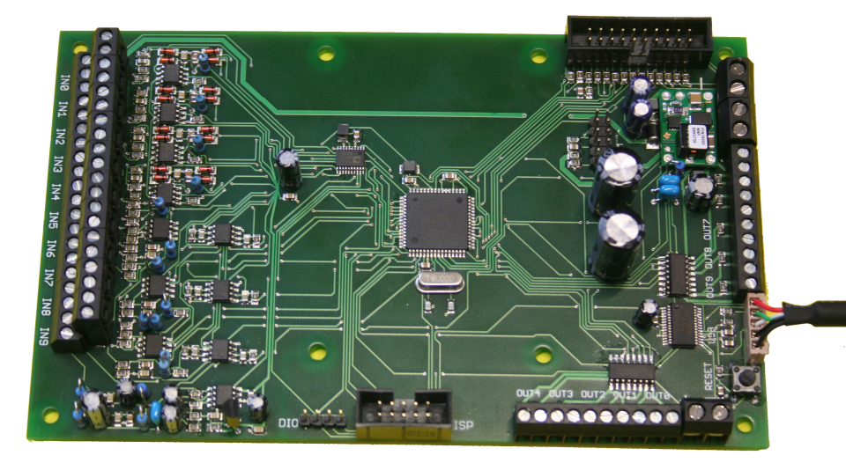
Hardware Details
ATmega128:
  8 Bit Mikrocontroller
  128 kByte Flash-Memory
  4 kByte EEPROM
  4 kByte SRAM
  16 MHz Clock Frequency
10 inputs for analogue, linear sensors
  Precision: 4 x 12Bit, 6 x 8Bit
10 binary outputs

Slide 14

Model Transformation & Code Generation

Slide 15
Implementation Details
Implementation realized in Java as Eclipse plug-ins
Eclipse Modeling Framework (EMF): Creation of Language Metamodels
Graphical Modeling Framework (GMF): Graphical editor for EMF Metamodels
Acceleo: Code Generation
EMF & GMF Code Generators provide basic implementations for Language Metamodels and Editors
Manual customization of implementation possible

Slide 16
Conclusion
Domain-specific Solution:
  Easily usable by domain experts
  Low development costs
  Short development times
  High quality
Key technology for entering a new market
Eclipse-based Solution:
  Low license costs
  Easy to extend

