Slide 1

A Domain-Specific Language to Define Multi-Touch Gestures
SPLASH Workshop on Domain-Specific Modeling, Reno/Tahoe, Nevada
Shahedul Huq Khandkar
Frank Maurer

Slide 2


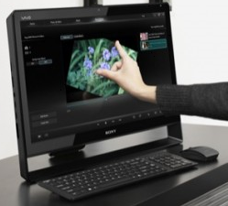
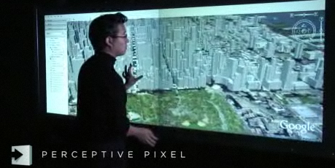

Touch Interfaces
The new medium of interaction
Key variations
Features
Physical structure
Source: Microsoft Research, apple.com, zatznotfunny.com, slashgear.com

Slide 3
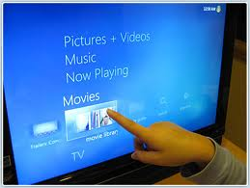
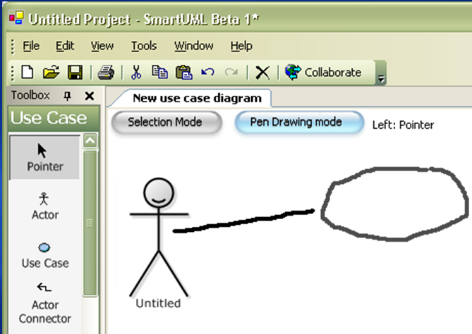
Use of Touch Interface
Generic application commands
Context specific commands

Slide 4
Existing Tools for Gesture Recognition
Predefined gestures
Application specific implementations
Template based recognition algorithms
Compares with sample dataset

Slide 5
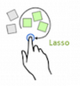
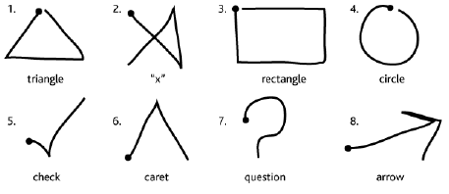
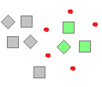
Limitations of Template based Recognition
Requires specific start and end point
Limited multi-touch & multi-step support
Hard to define conditional logic
Image: slashgear.com

Slide 6
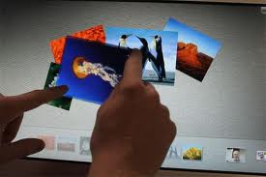

A DSL to define gestures
name: ZoomIn validate
Touch state: TouchMove and
Touch limit: 2 and
On same object and
Distance between points: increasing return
Distance, Distance changed

Slide 7

Defining Multi-step Gestures
Primitive Conditions
name: ActorObject validate as line1
Touch state: TouchMove and
Touch limit: 1 and
Touch shape: line and
Touch length: 100..200
validate as line2
Touch state: TouchMove and
…
validate
line1 perpendicularTo line2 and
… return
Position, Bounding box
Return Types

Slide 8
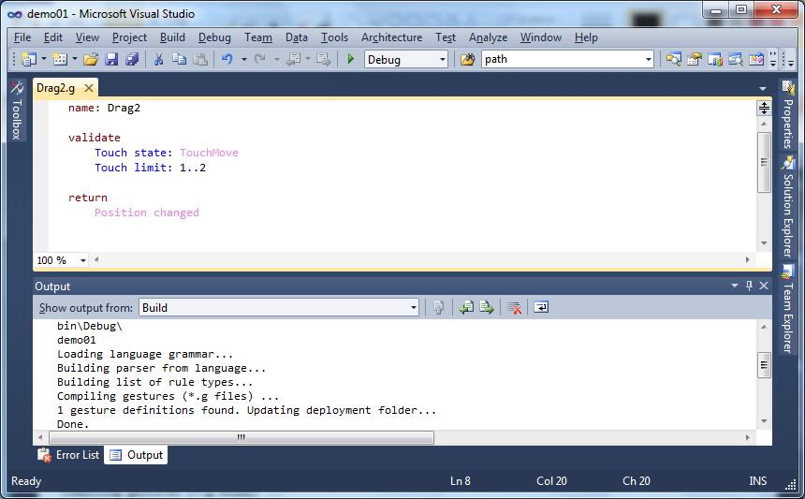
IDE Support

Slide 9

Primitive Conditions & Return types
The toolkit provides
15 primitive conditions
10 return types
Image: testmaster.in

Slide 10
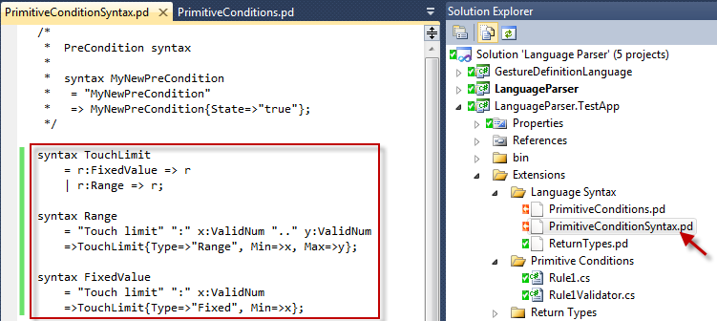
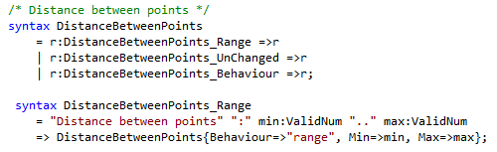
Extensibility
Define syntax (parsing logic)
Validation logic
C# or any other .NET supported language

Slide 11
Performance Benefits
Less computation – lazy evaluation
Reuse validated data
Touch b & c
Touch a & c
Touch b & c
3 touches (a, b, c)
Touch a &b
Touch a &b
Raw data
Return type Calculator
Touch limit: 2
On same object
…

Slide 12

On Going & Future Work
Generate definitions from samples
Visual representation of gesture definition
Image: aboutcellulars.com

Slide 13

Questions?
Gestures
Language structure
Extensibility
IDE support
http://touchtoolkit.codeplex.com
Image: huffingtonpost.com

